Slide 1

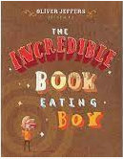
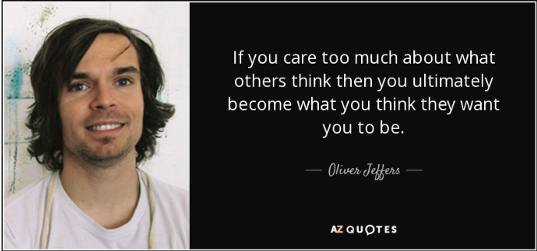
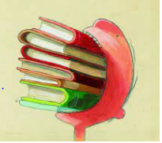
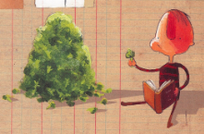
Year 2 English – The Incredible Book Eating Boy
Plot Summaryjjhjhjkhhhhhhhhhhhhdasjdajsssssss
This book tells the story of Henry who, discovers that he loves to eat books. He eats all sorts of books but red ones are his favourites. Henry soon learns that the more books he eats, the smarter he gets and he loves being the smartest person in the class. He begins to go through books at an alarming rate until things start to go wrong – everything he learns gets mixed up and he doesn’t have time to digest it properly. The doctors advise him to stop eating books because his belly can’t cope and it’s not fair on all the other people who want to read them. Having not eaten a book for a while, he finds a half-eaten book on the floor and instead of eating it he opens it up and READS it!
Name of Book:
The Incredible Book Eating Boy
Date Published: 2006
Author: Oliver Jeffers
Genres: Picture Book
Quotes j
“Henry loved books. But not like you and I love books, no. Not quite …Henry loved to EAT books.”
“The more he ate the smarter he got.”
“Then, after a while and almost by accident, Henry picked up a half-eaten book from the floor. But instead of putting it in his mouth … and began to read it.”
Setting hhhhhhhhhhhhhhh jjhjhjkhhhhhbh
This story explores Henry’s ability to eat books within his home and school. Within the story, Henry also visits a doctor surgery fo his habit of eating books. Henry also dreams of performing on stage too!
Main Charactersjdasldjaldjaljdlakjdlk ajdlb
Henry – Henry loves books! But not like you or I like books….Henry loves EATING books! The more he eats, the smarter he gets.
Doctor – Henry was taken to the doctor by his parents who advised him to stop eating books; but Henry did not listen.
Henry’s Parents: Mum and Dad – Henry was looked after by his Mum and Dad. They were worried about his eating of books and wished he would stop too.
Key Vocabularyjdasldjaldjaljdlakjdlkajdljasssssbhbhjjjjjjjjjjj
Decide- make a decision between two given options etc..
Favourite – a person’s thing / opinion that is well liked
Aspired- direct one’s hopes to achieving something
Digest – to break down food once eaten in the body
Advised – acting in a way that is recommended
Accident – an incident that happens unexpectedly without deliberate cause.
Read - to disover information by looking at a written source
Smarter – to grow in knowlegdge and intelligence over a period of time.

