Slide 1


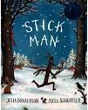
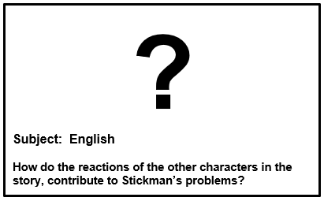
Year 1 English – Stick Man
Plot Summaryjjhjhjkhhhhhhhhhhhhdasjdajsssssss
Stick Man tells the story of Stick Man who leaves his family tree one morning and finds himself being mistaken for a normal stick being used as a variety of objects, for example an arm for a snowman and a sword for a knight! He is desperately trying to find his was back to his family tree, however the harder he tries, the further away he seems to find himself. Just as Stick Man is falling asleep and feeling ready to give up he wakes to find himself about to be used as a stick for a fire. Suddenly, a noise from the chimney startles him and Stick Man finds himself on an even bigger adventure.
Author: Julia Donaldson
"I opened a book and in I strode.
Now nobody can find me.
I've left my chair, my house, my road,
My town and my world behind me.
I'm wearing the cloak, I've slipped on the ring,
I've swallowed the magic potion.
I've fought with a dragon, dined with a king
And dived in a bottomless ocean.
I opened a book and made some friends.
I shared their tears and laughter
And followed their road with its bumps and bends
To the happily ever after.
I finished my book and out I came.
The cloak can no longer hide me.
My chair and my house are just the same,
But I have a book inside me."
Name of Book:
Stick Man
Date Published: 2008
Author: Julia Donaldson
Genres: Picture Book
Quotes j
“Stick Man lives in the family tree
With his Stick Lady Love and their stick children three.”
“I'm Stick Man, I'm Stick Man,
I'M STICK MAN, that's me,
and I want to go home to the family tree!”
“A scratch and a scrape and a flurry of soot.
A wiggle, a jiggle, and – out pokes a foot!!
Setting hhhhhhhhhhhhhhh jjhjhjkhhhhhbh
This story is set in England. Stick Man on his adventures visits lots of places such as a beach, a river, a park and a forest exploring a range of different seasons from Winter to Summer to Spring and Autumn.
Key Vocabularyjdasldjaldjaljdlakjdlkajdljasssssbhbhjjjjjjjjjjj
twig- a thin piece of wood fallen from a tree.
stuck – to push through something
boomerang- a curved piece of wood that when thrown will return back
family – a group of parents living with several children in a unit
frozen– ice due to extreme cold weather
snowman – a human figure made of compressed snow
choir- an organised group of singers who perform to an audience
bat– usually made of wood to hit a ball in various games.
Main Charactersjdasldjaldjaljdlakjdlk ajdlb
Stick Man – the main character of the story. A boy character who is an ordinary, brown woodland stick
Stick Man’s Family – this is made up of Stick Man’s 3 children and his wife.
Santa / Father Christmas - the rescuer of the story; helping Stick Man get home to the family tree in time for Christmas.

