Slide 1
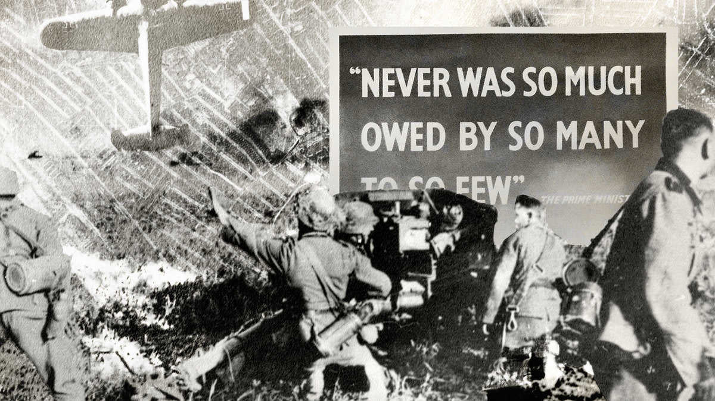

French – La Seconde Guerre Mondiale LI: To be able to use decoding skills to understand better unknown language in French.
Key Skills and Concepts To be able to learn effective strategies that will help to decode and understand better unfamiliar vocabulary. Language learning strategies that are transferable and not limited to the language covered in this unit.
Key Grammar Recycling and consolidation of the language learning skills connected to recognising and categorizing nouns, verbs and adjectives.
Phonics
qu = k ç = s an = on (nasal)
gne = nyuh en = on (nasal)
QU sound as in Tchécoslovaquie
Ç sound as in français
GNE sound as in Allemagne or Pologne
AN sound as in Angleterre, amusant or dangereux
EN sound as in parents or enfumé
Silent letters
‘s’ is not pronounced in anglais or français
‘t’ is not pronounced in amusant
‘x’ is not pronounced in dangereux
Key Vocab
l‘Angleterre = England
la France = France
l‘Italie = Italy
l‘Allemagne = Germany
la Pologne = Poland
la Tchécoslovaquie =
Czechoslovakia
les États-Unis = USA
on parle = you speak (En
France on parle.. = in
France you speak..
l‘anglais = English
le français = French
l‘italien = Italian
l‘allemand = German
le polonais = Polish
le tchécoslovaque = Czechoslovakian
calme = calm/tranquil
sans danger = safe
triste = sad
convivial = friendly
sombre = gloomy
sain = healthy
dangereux = dangerous
enfumé = full of smoke
Expectations Group and order words to decode unknown language. Understand the key facts of history from WW2 in French. Say and write in French the key countries and languages involved in WW2. Write a letter in French home explaining what life is like as an evacuee living in the countryside.
Yr 6

Slide 2



