Slide 1
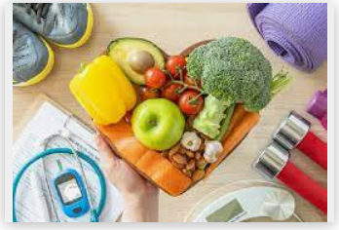

French – MANGER ET BOUGER- To discuss a healthy lifestyle in French.
Key Grammar
First person singular conjugation of high frequency verbs, use of the negative & imperative instructions. Use of manger in first person singular (je mange) and also boire (je bois) also in their negative form (je ne mange pas & je ne bois pas). Exploring verbs in the imperative form to give instructions.
Key Skills and Concepts To improve decoding unfamiliar texts in French using key language learning strategies that will help long term memory retention and language learning going forward. Understanding that adjectives come in different forms and when you describe a person in terms of a profession adjectival agreement rules will apply and spelling may change in these words.
First person singular conjugation of high frequency verbs, use of the negative & imperative instructions. Use of manger in first person singular (je mange) and also boire (je bois) also in their negative form (je ne mange pas & je ne bois pas). Exploring verbs in the imperative form to give instructions.
Phonics:
Phonics focus: QU Ç GNE EN AN
QU sound in électroniques
AN sound in manger, santé, viande & mélangez Silent letters.
The ‘s’ is not pronounced in heures. The ‘t’ is not pronounced in amusant, barbant or fatigant.
These two letters are often silent when they are the final consonants in words.
Key Vocab
de la viande blanche
des noisettes
des légumes
des fruits
du chocolat
des boissons sucrées
du beurre
de la viande rouge
du lait entier
du pain blanc
du fromage allégé
Expectations: Say and write what we eat and drink to stay healthy. Say and write what we do not eat and drink to stay healthy. Say and write the activities we do and do not do to stay in shape including a choice of physical activities. Follow a simple, healthy recipe in French.
Yr 6

