Slide 1


Nursery Curriculum Meeting
Notes:
‹#›

Slide 2

For being on time at the start and the end of the day.
For bringing your child’s water bottle everyday.
For putting your child’s name on EVERYTHING.
Notes:
We would just like to say Thank you for ensuring that your child is on time everyday, it is particularly important that for the first few weeks you collect your child on time as for some children it will unsettle them if you are late.
Emphasis on labelling EVERYTHING!! Jumpers will not be found easily if they get lost if things are not labelled.
‹#›

Slide 3
Development matters – the foundation stage curriculum
In nursery we follow the Early Years Curriculum
Birth to 3 years old
3 and 4 years old
Reception
ELG
Notes:
‹#›

Slide 4

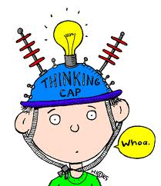
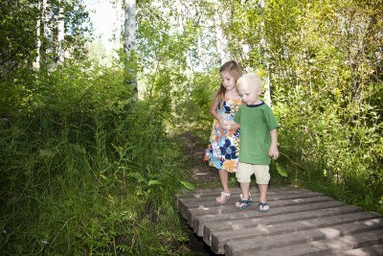
Characteristics of Effective learning
Within the curriculum there is a section called characteristics of effective learning. This is an important element that we look at when planning for your child and thinking about their development. We encourage your child to learn by using these skills.
Playing and exploring
Active learning
Creating and thinking critically
Notes:
‹#›

Slide 5

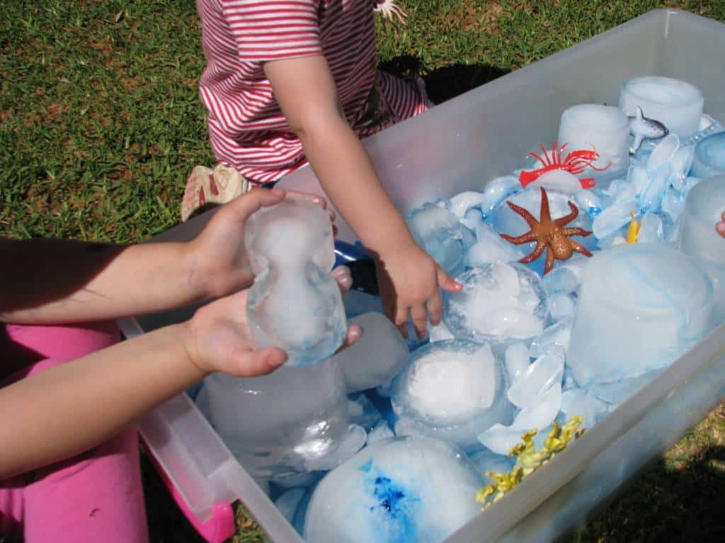
Playing and Exploring
Children investigate and experience things and have a go.
Respond to new experiences
Make independent choices
To plan and think ahead in their play

Slide 6
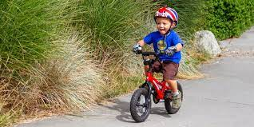
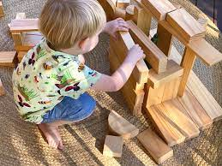
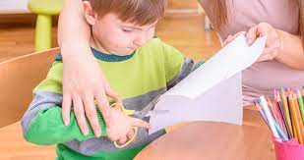
Active Learning
Children concentrate and keep on trying if they encounter difficulties, and enjoy achievements
Begin to understand routines
Show goal directed behaviour
Begin to correct mistakes
Keep on trying

Slide 7
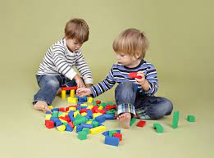
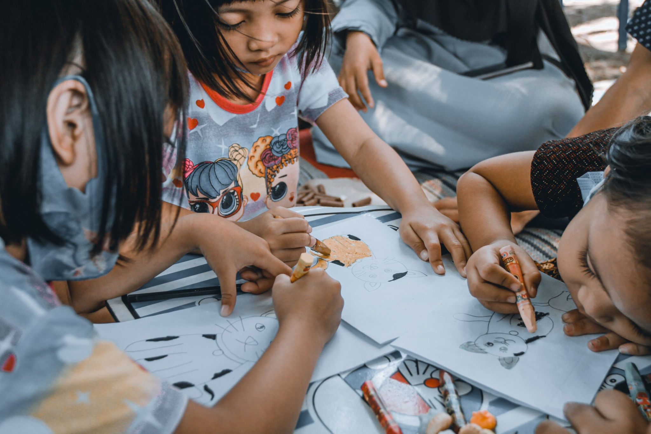
Creating and Thinking Critically
Children have and develop their own ideas, make links between ideas, and develop strategies for doing things
Solve real problems
Use pretend play to think beyond the here and now
Feel confident coming up with their own ideas
Concentrate on something that is important to them.

Slide 8
The curriculum is broken down into 7 key areas.
Prime areas
Personal, Social and Emotional development
Communication and language
Physical Development
Specific areas
Literacy
Mathematics
Understanding the world
Expressive arts and design
Notes:
This is a list of the 7 key areas of learning within the curriculum. The Prime areas are the first crucial steps in the foundation stage and the children need to be progressing in these areas in order to support themselves in the specific areas. The 7 areas are broken down into 17 subheadings.
‹#›

Slide 9


Communication and language
1. Listening, attention and understanding
2. Speaking
Communication and language development involves giving children opportunities to experience rich language within a thriving environment; to develop their confidence and skills in expressing themselves to speak and listen in a range of situations.
Notes:
‹#›

Slide 10
Communication and language
Listening to stories and rhymes
Singing songs
Encouraging children to talk and listen
Notes:
‹#›

Slide 11



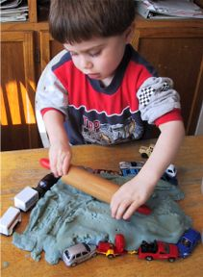
Physical Development
3. Gross Motor Skills
4. Fine Motor Skills
Physical development involves providing opportunities for young children to be active and interactive and to develop their co-ordination, control and movement.
Notes:
‹#›

Slide 12
Physical Development
Providing opportunities for running jumping climbing swinging
Providing different types of tools Scissors hammers spades mark making tools
Different materials to use clay playdough foam.
Encouraging independence putin on coats and shoes beginning to manage buttons and zips
Notes:
‹#›

Slide 13

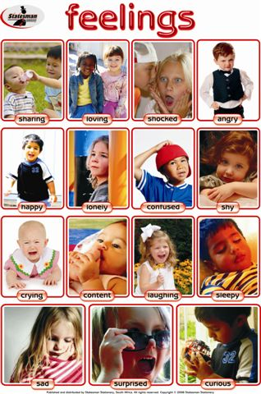
Personal, Social and Emotional development
5. Self regulation
6. Managing self
7. Building relationships
Personal, social and emotional development involves helping children develop a positive sense of themselves and others; to form positive relationships and develop respect for others; to develop social skills and learn how to manage their feelings; to understand appropriate behaviour in groups and to have confidence in their own abilities
Notes:
For each area of learning there are ‘aspects’ for Personal social and emotional development they are……
‹#›

Slide 14
Personal, Social and Emotional development
Encourage children to share and take turns
To be able to play with other children
Help children to manage their feelings when things don’t go to plan
To be able to follow simple rules
Begin to understand how others might be feeling
Notes:
For each area of learning there are ‘aspects’ for Personal social and emotional development they are……
‹#›

Slide 15
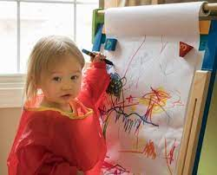
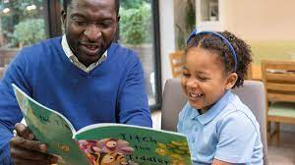

Literacy
8. Comprehension
9. Word reading
10. Writing
It is crucial for children to develop a life-long love of reading. Reading consists of two dimensions: language comprehension and word reading. Language comprehension (necessary for both reading and writing) starts from birth. It only develops when adults talk with children about the world around them and the books (stories and non-fiction) they read with them, and enjoy rhymes, poems and songs together. To notice print .
Notes:
‹#›

Slide 16
Literacy
Reading
Sharing books in groups and one to one
Joining in with songs and rhymes
developing play around stories
Notes:
‹#›

Slide 17
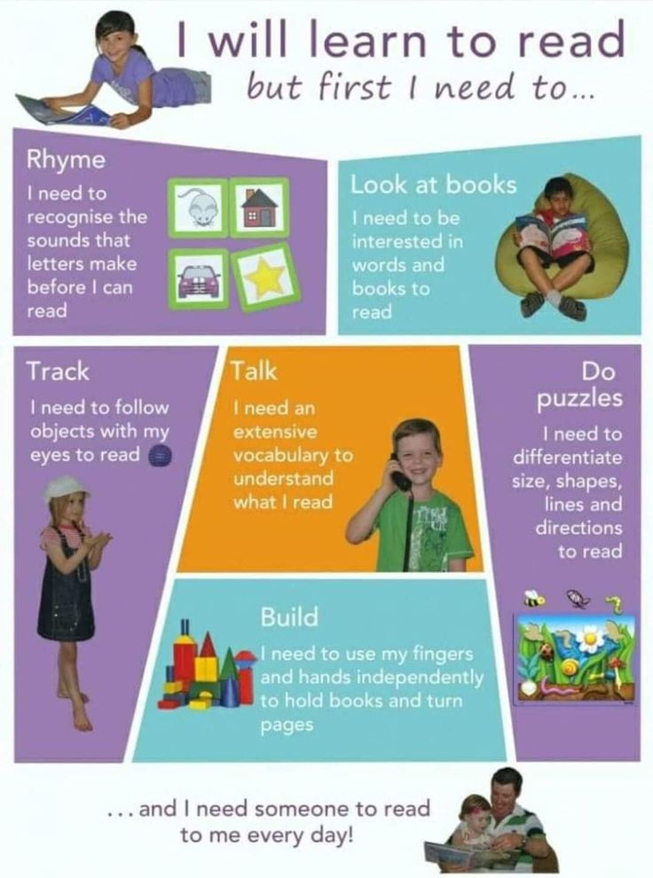
Literacy
Before I can Read…
I need to recognise the sounds letters make.
I need to be interested in the pictures and words in books
I need to be able to follow objects with my eyes
I need a large vocabulary
I need to be able to do puzzles to differentiate different shapes
I need to be able to use my hands and fingers independently
Notes:
‹#›

Slide 18
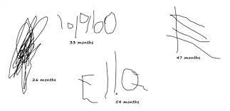

Literacy
Writing
To be able to draw freely
To begin to add marks to drawing
To talk about their pictures
To begin to form some recognisable letters
Notes:
‹#›

Slide 19
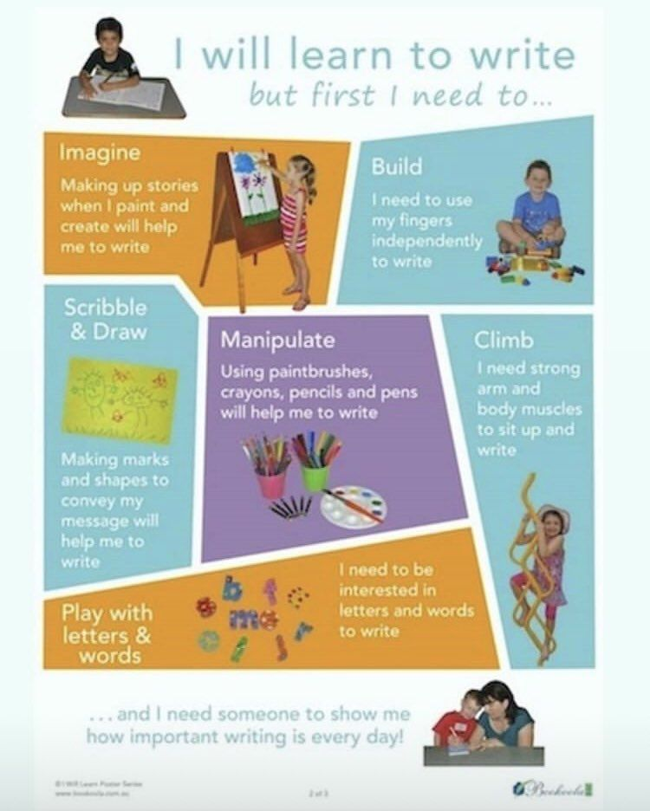
Literacy
Before I can write…
Ineed to…
Imagine make up stories
Build I need to be able to use my finger independently
Draw and scribble
Use paintbrushes crayons and pens
Climb I need strong muscles to be able to sit up and write
I need to be interested in letters and words
Notes:
‹#›

Slide 20
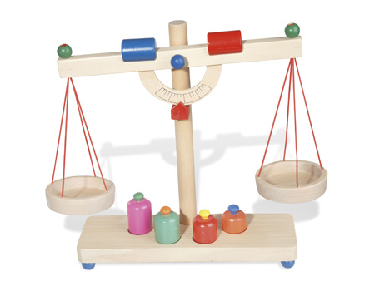


Mathematics
11. Number
12. Numerical Pattern
Mathematics involves providing children with opportunities to develop and improve their skills in counting, understanding and using numbers, calculating simple addition and subtraction problems as well as describes shapes, spaces and measures.
Notes:
‹#›

Slide 21
Mathematics
We provide opportunities for counting all types of objects
Singing number rhymes
Using positional language
Comparing objects by size
Talk about shape
Notes:
‹#›

Slide 22


Understanding the World
13. Past and Present
14. People, culture and communities
15. The Natural World
Understanding the world involves guiding the children to make sense of their physical world and their community through opportunities to explore, observe and find out about people (both past and present), places and their environment.
Notes:
‹#›

Slide 23
Understanding the World
Explore different materials
Talk about what they can see and hear
Talk about their family begin to make sense of their life history
Celebrate different festivals
Explore how things work.
Notes:
‹#›

Slide 24
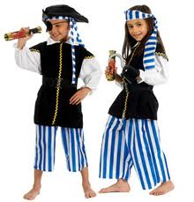


Expressive arts and design
16. Creating with materials
17. Being imaginative and expressive
Expressive arts & design involves enabling children to explore and play with a wide range of media and materials, as well as providing opportunities and encouragement for sharing their thoughts, ideas and feelings through a variety of activities in art, music, movement, dance, role-play, design & technology.
Notes:
‹#›

Slide 25

Electronic learning journals
We are using Learning Book to take focussed observation of your children doing different activities linked with the areas of learning. Children will be observed at different times throughout the term. You will be receiving an email with their login for learning journey later on. We will let you know when the emails will be sent to you.
Notes:
Let parents know that we are upgrading our devices with the new framework so they will receive an email with their log in for learning book later on. They will need to create their own passwords.

Slide 26
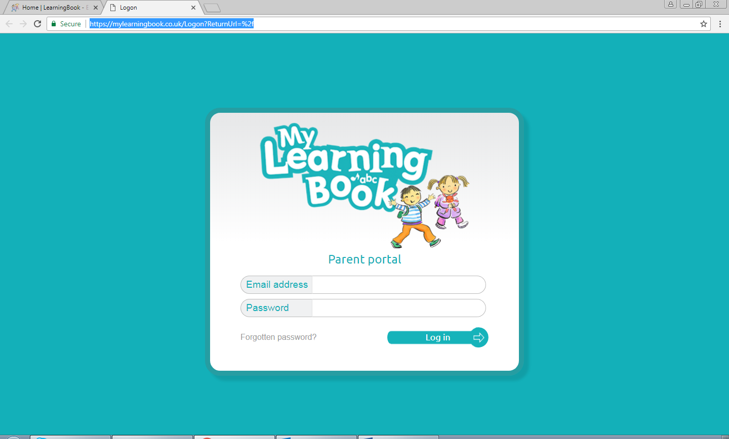
Recording children’s learning
When the system will be available, you can log in any time to see what areas of learning your child is being observed in.
You can add photos too!

Slide 27

Any Questions
Please come and speak to me any time if you have questions about what we are doing at nursery or if you want ideas about how to help your child.
It is a privilege to work with your child but you are the most important people in their development and you know your child the best.

Slide 28
Contact details
Barn Owl Class – Mrs Siddiqui
s.siddiqui@westbrookprimary.co.uk
Snowy Owl Class – Mrs Presepi
s.presepi@westbrookprimary.co.uk
Tawny Owl Class – Miss Dias
e.balaban@westbrookprimary.co.uk

