Slide 1

Electronic learning journals
You will be receiving an email with their log in for learning journey, please check your junk mail if you have not received it yet or speak to your child’s class teacher.
Notes:
Let parents know that they should have received an email with their log in and passwords for learning journey

Slide 2
Recording children’s learning
All independent learning will be on the electronic journal.
You can log in any time to see what your child is choosing to do in class.
You can add photos too!

Slide 3
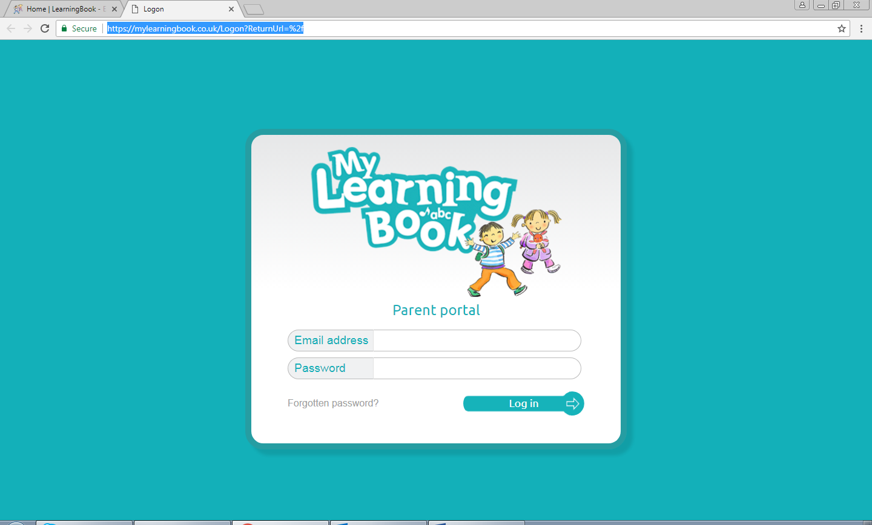
Google ‘My learning book’

Slide 4
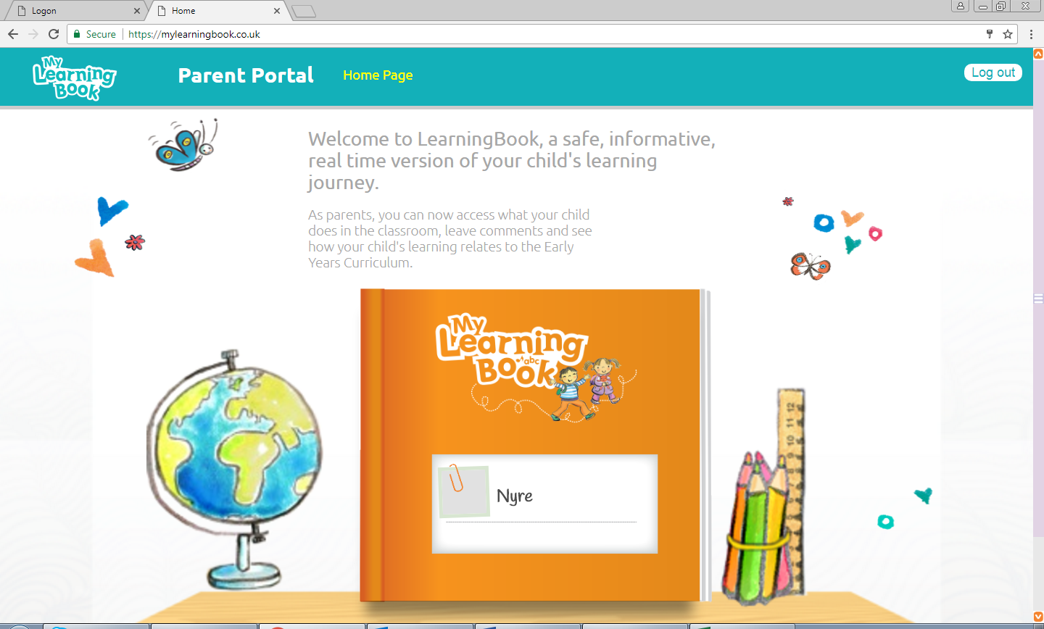
Click on the book to turn the pages. You can look at photos, watch videos and leave comments if you wish.

Slide 5
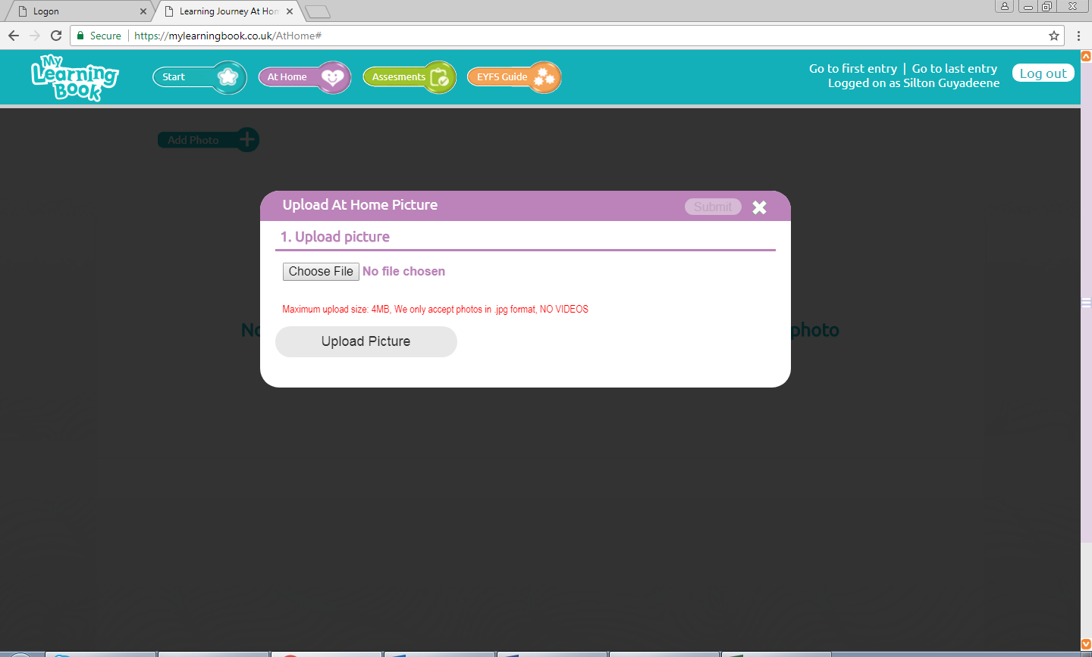
Click on ‘at home’ to add your own photos. We want to see what you child is doing at home too. Club and activities too.
Notes:
Assessment button will not be used as we have a whole school tracking system that we use so please don’t worry that you are not seeing information in that section.

Slide 6
We need you too!
You know your child the best and you can give us feed back too.
You tell us!– a way of giving us a snippet of home life/activities that all contribute to learning and development milestones.
Supporting your child with home learning and reading.

