Slide 1

Year Two
Phonics Screening Check Meeting
Mrs Keane
Assistant Headteacher KS1

Slide 2

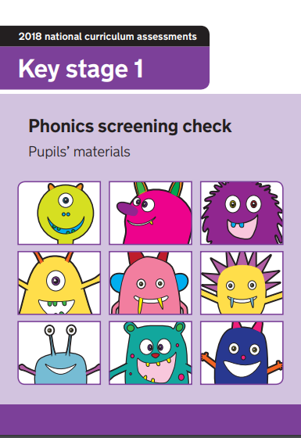

Phonics and RWI at Westbrook Primary School

Slide 3
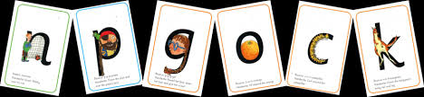
Phonics: All words are made up of sounds
In English there are 44 sounds

Slide 4
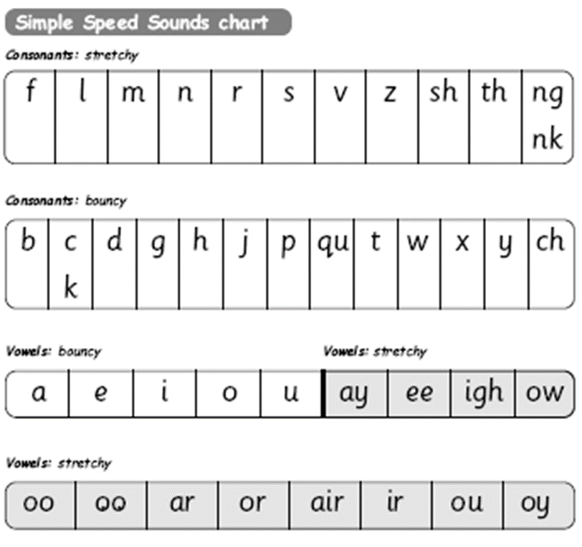
Children learn a simple code first.
c-a-t
ch-a-t
l-igh-t
c-r-a-sh
When two or more letters make a sound we call this a special friend.

Slide 5
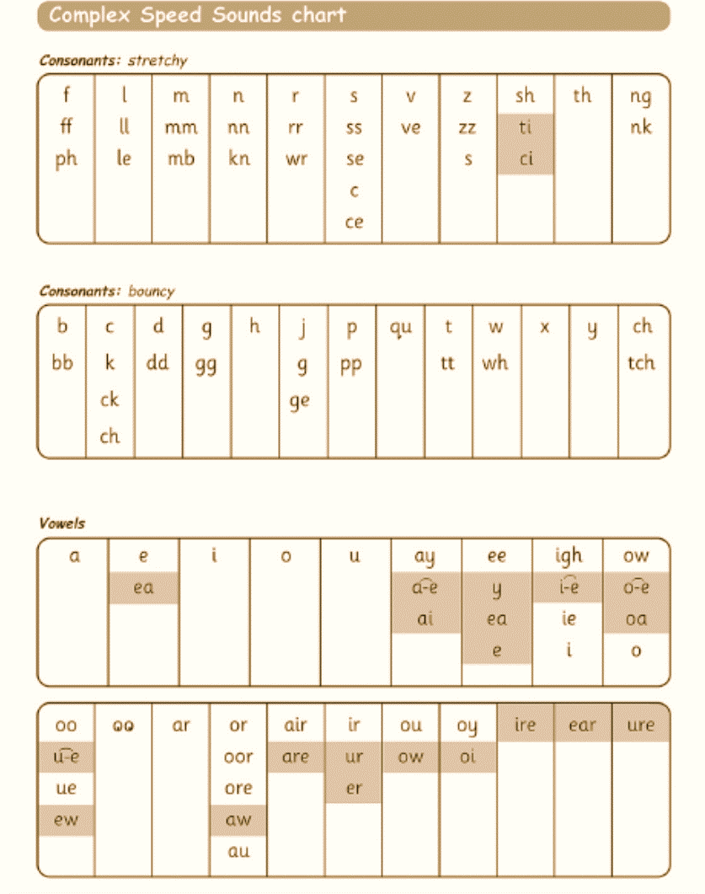
Further sets of sounds
Then they learn the Set 3 sounds
These are the final set of sounds and the alternative spellings for each sound
sat
kiss
horse
circle
rice

Slide 6
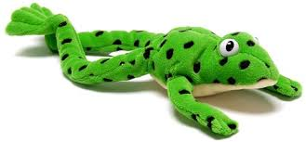

Reading and spelling words
For children to be able to read unfamiliar words correctly they must:
Firstly identify the sounds and if the words have any special friends in them.
Then secondly blend the sounds together to read.
Fred the Frog can only speak in sounds and children blend the sounds together to read.
Fred Fingers can be used to spell words. Children hold up a finger to represent each sound and then press them as they sound words out.

Slide 7
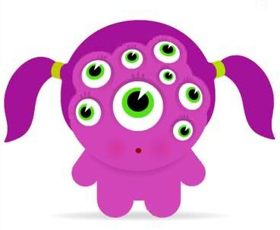
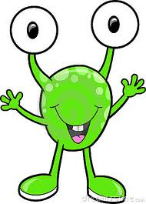
The Phonic Screening Check

Slide 8
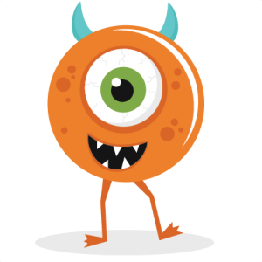
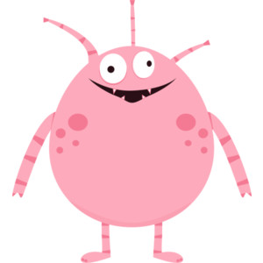
Purpose of the Phonics Screening Check
Introduced in 2012 to ‘confirm that all children have learned phonic decoding to an age-appropriate standard.’
Used to identify children requiring extra support.
Usually all children take the test in Year 1. Due to the lockdown down last academic year, the Government announced that all children returning to Year 2 in September are required to take the test.

Slide 9
When? Where? How?
December 2020
All children will take the check on one day during the month of December 2020.
Your child’s punctuality and attendance during this week is of utmost importance.
The test will be taken in a quiet room 1:1 with your child’s teacher.
The test will last between 5-10 minutes.
Children are very familiar with the structure of the test, they will be very relaxed and there is no need to worry.

Slide 10
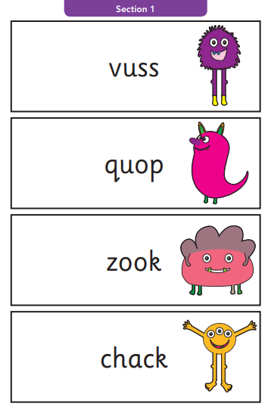
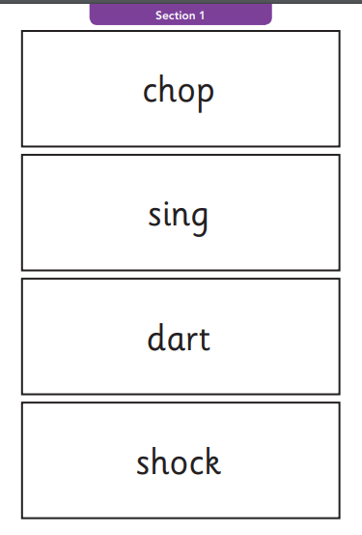
Format: Real words and monster words
40 words in total
20 real words and 20 monster words.
4 words per page. Split into 2 sections.
Children have to read the words correctly.
Section 1 words have simple word structures and common ‘special friends’

Slide 11
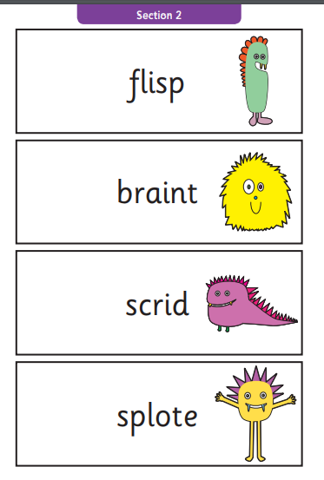
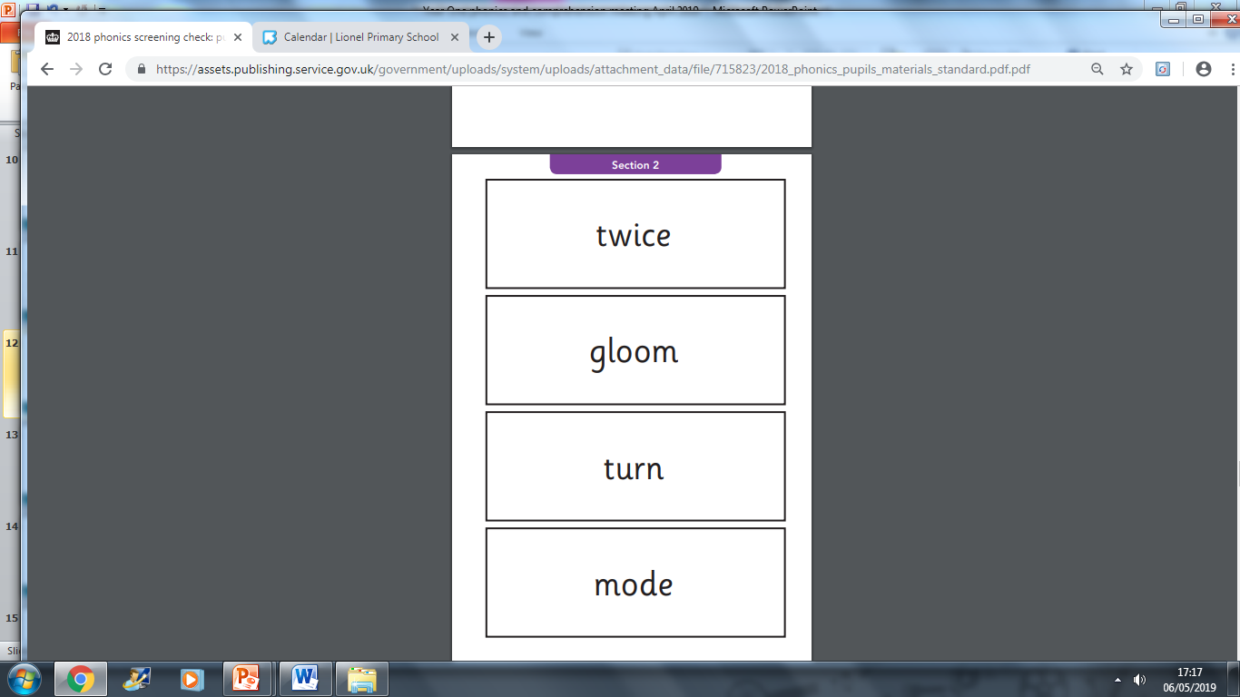
Section 2 words have more complex word structures and less common ‘special friends’

Slide 12
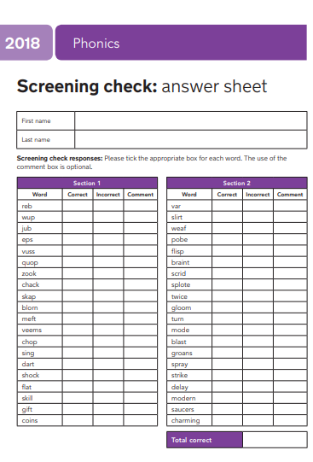
Results
Teachers will record if children have read the words correctly or incorrectly.
Results will be reported to parents when the pass mark is released. (January 2021)
Please note: we are awaiting for confirmation that the threshold mark will remain the same as in previous years. Children who do not meet the threshold mark will have to retake the test again in June 2021.

Slide 13
How you can help at home
By knowing the 44 pure sounds and practicing them with your child.
By knowing how to blend using Fred Talk for reading
By knowing how to use Fred Fingers for spelling
By practising reading monster words
By encouraging your child to look for the special friends in words
Reading with your child at home
Discussing any words your child does not understand

Slide 14
Helpful resources
Previous tests (2016, 2017, 2018) are available online to practice with. https://www.gov.uk/government/collections/national-curriculum-assessments-practice-materials#phonics-screening-check-resources
How to say each sound correctly https://www.ruthmiskin.com/en/find-out-more/parents/#lg=1&slide=2
Phonics play games practising real and monster words https://www.phonicsplay.co.uk/ChildrensMenu.htm
Frequently asked questions about the check:
https://www.oxfordowl.co.uk/for-home/at-school/assessment-at-primary-school/phonics-screening-check/

Slide 15

Questions

