Slide 1

Phonic Screening Check 2019
Notes:
Welcome to this read write inc and phonic session, I hope you find this useful and that I can address queries you may have.

Slide 2

What will this meeting cover?
Read Write Inc- what are your children doing now in phonics?
Phonic Screening Check 2019
What can you do at home to help your child?
Notes:
Today we will cover 3 areas, firstly I will show you a speed sound lesson, the speed sound lesson is the first 10 min of a rwi lesson. I will then explain to you what will happen in the phonic screening check and finally I will talk to you about what you can do at home to support your childs learning.

Slide 3
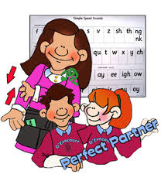

How does RWI work?
Learn 44 sounds and matching letters
Learn to blend the sounds to read words
Read lots of specially written books
Work along side a ‘learning partner’ building confidence.
Use their phonic skills to complete writing tasks based on the storybooks.
Notes:
Firstly the ch will learn their sounds (this began in reception, with first ch learning what we call simple sounds) they then go on to learn their complex sounds, but at the same time they are also learning to blend to read the sounds they have learnt and write them.
When the ch have learnt their first set of sound sand can blend they start the storybook programme where they read books with the sounds in which they have learnt, as they learn more sounds and can read the books easilly they then go up to the next level untill they have learnt to read all the sounds and the different spellings of the sounds.
In the storybook lessons ch share books with their ‘learning partner’ using a lolly stick they take it in turns to read with each child ‘being the teacher’
This builds confidence and partner skills as well as enveloping the theory that you can only really know something when you teach someone else. They corrrect each other and support each other in their partners.it gives ch a strong sense that they ‘know what they know’ indepence and self esteem therefire flourishes. It is also a key assessment tool for teachers.
After the children have read the story they will then complete a writing task.
Using Read Write Inc the children learn to read effortlessly so that they can put all their energy into comprehending what they read.
It also allows them to spell effortlessly so that they can put their energy into composing what they write.

Slide 4
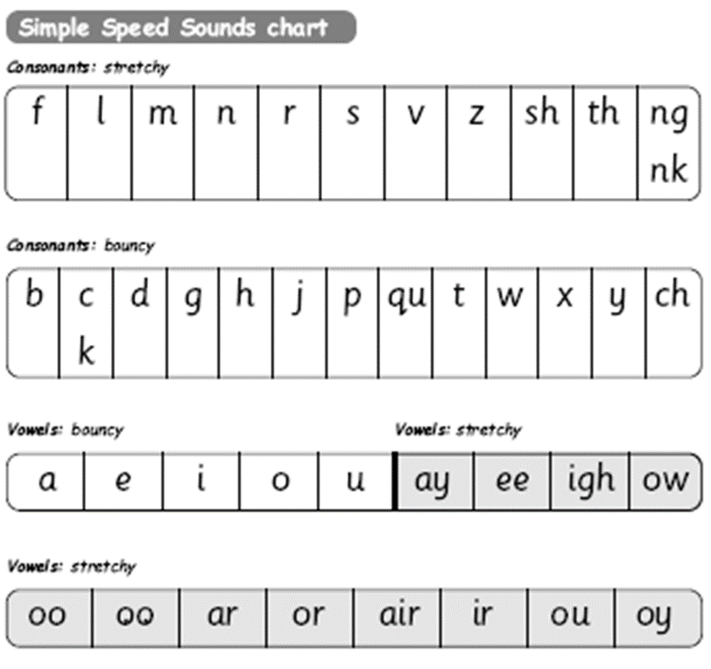
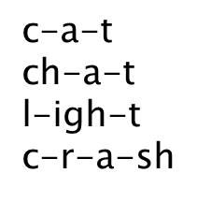
All words are made up of sounds
In English there are 44 sounds
Children learn a simple code first.

Slide 5
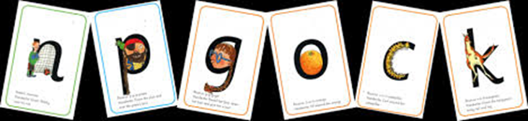
The complex English alphabetic code!
This chart shows the most usual graphemes for the 44 sounds
Notes:
A grapheme is a sound written down (phoneme is the spoken sound)
English has more than 150 graphemes
A complex code! Here you can see all the differnt ways the sounds are written

Slide 6
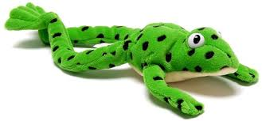
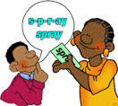
Fred
Fred helps children learn to read
Fred can only talk in sounds...
(Fred can only say r_ai_n, he can’t say rain)
We call this Fred Talk
If children understand Fred they can blend orally
Blending is needed for reading
Notes:
Some of you may be familiar with ‘fred’, he only speaks in pure sounds-children need to blend the sounds her ays to hear and read words.

Slide 7

Fred fingers
Fred helps children learn to spell too!
Children convert words into sounds
They press the sounds on to their fingers...
We call this Fred Fingers
Fred spelling
The children spell the words onto their fingers.
Have a go!
Notes:
Fred fingers-demo-get parents to tell how many sounds in ‘dog’ ‘snow’ if can ‘cake’
Fred spelling-

Slide 8
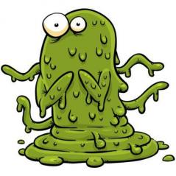

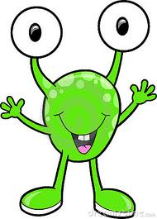
The Phonic Screening Check
‘When you see the monsters face, Fred talk please no need to race’
https://www.youtube.com/watch?v=_UIv63W9StE
Notes:
The phonic screening check is a test of 40 words in 2 sections, generated by the government to allow us to see how children have progressed. The children will need to achieve a pass mark of 32 out of 40 to pass. If your child does not pass they will retake in yr2. last year we achieved 98% and so we will be working very hard to continue with our high expectations.
The test has 2 sections and each will consist of monster words and real words and the child will complete this test with their class teacher 1:1. the child will read each word, when they see a monster word they will be encouraged to stop and fred talk.

Slide 9
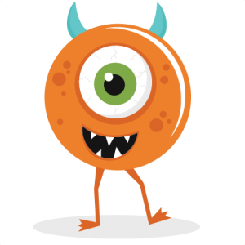
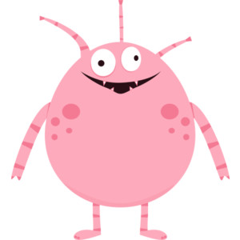
What is the phonics screening check?
"The phonics screening check is a short, simple assessment to make sure that all pupils have learned phonic decoding to an appropriate standard by the age of 6. All year 1 pupils in maintained schools, academies and free schools must complete the check.
The phonics check will help teachers identify the children who need extra help so they can receive the support they need to improve their reading skills. These children will then be able to retake the check in year 2.
The check comprises a list of 40 words and non-words which the child will read one-to-one with a teacher."
(Department for Education)

Slide 10
When? Where? How?
This Years Phonic Check will take place the week beginning 10th June 2019.
Your child’s punctuality and attendance during this time is of high importance. The test will be taken in a quiet room with your child’s teacher. The test will last between 5-10 minutes.
Children are very familiar with the structure of the test, they will be very relaxed and there is no need to worry ☺

Slide 11

How do we achieve success with the Phonic Screening Check at Westbrook Primary School?
All staff who teach your children are well trained, have high expectations ,enthusiastic and believe in the programme as well as wanting your children to achieve THE BEST that they possibly can.
Regular assessment of the children to close the gaps, we make sure no children are falling behind.
Little and often – practice makes perfect! This includes the sounds and Monster Words. It is so important that the children are able to quickly spot the special friends in all words, as well as segmenting and blending words back together. The more practice in short bursts, the easier they find it to learn. Children are constantly exposed to the format of the test and the Monster words.
We make it fun! Rewarding the children with lots and lots of praise when they are getting it right.
Notes:
I have already identified the ch I need to work with this year, if your child’s progress slows down we will update you.

Slide 12
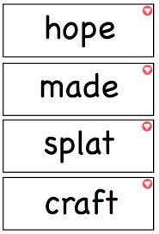
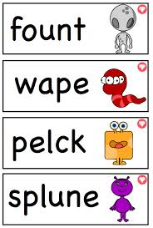
What does it look like?
Notes:
This is what it looks like, it will take about 10 mins, not stressful for the child.

Slide 13
So….how can you help?
By knowing the 44 pure sounds
By practising reading the Speed Sounds with your child
By knowing how to blend using Fred Talk for reading -m_ay= may
By knowing how to do Fred Fingers for spelling
By practising the Monster/Alien words for the phonic check
By encouraging your child to look for the special friends in words
Reading with your child at home
/

Slide 14
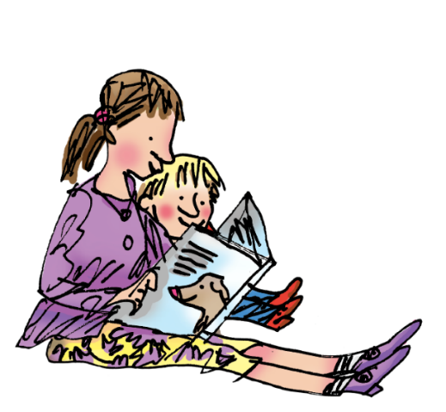
Children who read at home do well at school.
You can read stories with your child. Relentlessly.
Read favourite stories over and over again
Read some stories at a higher level than they can read themselves.
Listen to them reading their take home storybooks.

Slide 15


Any Questions?

Slide 16
Thank you for coming

