Slide 1


What is Mathematics Mastery?
A guide for parents and carers 2018

Slide 2
What is “Mathematics Mastery?”
Mathematics Mastery is a not-for-profit organisation.
Vision
For every child to enjoy and succeed in mathematics, regardless of background.
Mission
To transform mathematics education in the UK. We work in partnership to empower and equip schools to deliver world-class mathematics teaching.
Notes:
Mastery is an often discussed term in education. Mathematics Mastery started in 2012 with 20 schools and has expanded to around 400 primary schools and 200 secondary schools in 2018. Our vision is that all children enjoy and succeed in maths, no matter what their starting points. We do this by giving schools the resources and training to better support their teachers to achieve this.

Slide 3

Core belief
Mathematics Mastery schools want every child to succeed in maths, no matter what their backgrounds and starting points.
Success in mathematics for every child is possible.
Mathematical ability is not innate, and is increased through effort.
Notes:
Discuss with parents what this means. Did they enjoy maths at school? How many of them feel they are no good at maths? Is it true that some people are born with a ‘maths gene’, that they are naturally better at maths? Mathematics Mastery believe that all children can do better in maths through good teaching. As a nation, we do not do well enough in maths and we know we need to change perceptions of maths from parents and carers.

Slide 4
What is mastery?
“In mathematics, you know you’ve mastered something when you can apply it to a totally new problem in an unfamiliar situation.”
Dr. Helen Drury,
Executive Director and founder of Mathematics Mastery
Notes:
Discuss with parents what this means. Can they think of examples outside of maths where this is true? (E.g. in learning to drive a car, you may feel you have mastered it when you can drive a different car, drive in snow and on ice, when you apply the skills of driving a car to driving a van etc.)

Slide 5
What does this mean in practice?
Fewer topics in greater depth
Mastery for all pupils
Number sense and place value come first
Problem solving is central
Notes:
Emphasis on number work throughout. Topics are revisited throughout the year in slightly different ways so that pupils really embed their learning.
Opportunities are provided throughout the programme for pupils to use reasoning skills to make connections between prior knowledge and newly presented material. These connections will help foster a deeper understanding of mathematical concepts.
Differentiation is through depth rather than accelerating children on to new content. This means that pupils who grasp concepts quickly are challenged through rich problem solving tasks, to explain their working, to justify and reason.
Traditional methods of working out are meaningfully taught. A clear progression in calculations document from MM ensures consistency and continuity across the school.
Comprehension, calculation and problem solving developed simultaneously.

Slide 6
Lesson structure
Mathematics Mastery lessons follow a 6-part structure. This keeps the lesson pacy, gives flow and allows more opportunities to teach creatively, give feedback and assess learning.
Pupils have access to plenty of concrete materials such as bead strings and cubes/counters so that they have time to fully explore mathematics.

Slide 7
Curricular principles
Pupils are not going to be working through the curriculum more quickly, but going deeper into it. In Year 1 it is imperative that pupils have full understanding of number sense, number bonds and place value, as all number work in maths builds on what is taught in this year group.

Slide 8
Mathematical language
Mathematics Mastery lessons provide opportunities for pupils to communicate and develop mathematical language through:
Sharing essential vocabulary at the beginning of every lesson and insisting on its use throughout
Modelling clear sentence structures using mathematical language
Paired language development activities, known as Talk Tasks.
Plenaries which give a further opportunity to assess understanding through pupil explanations.

Slide 9
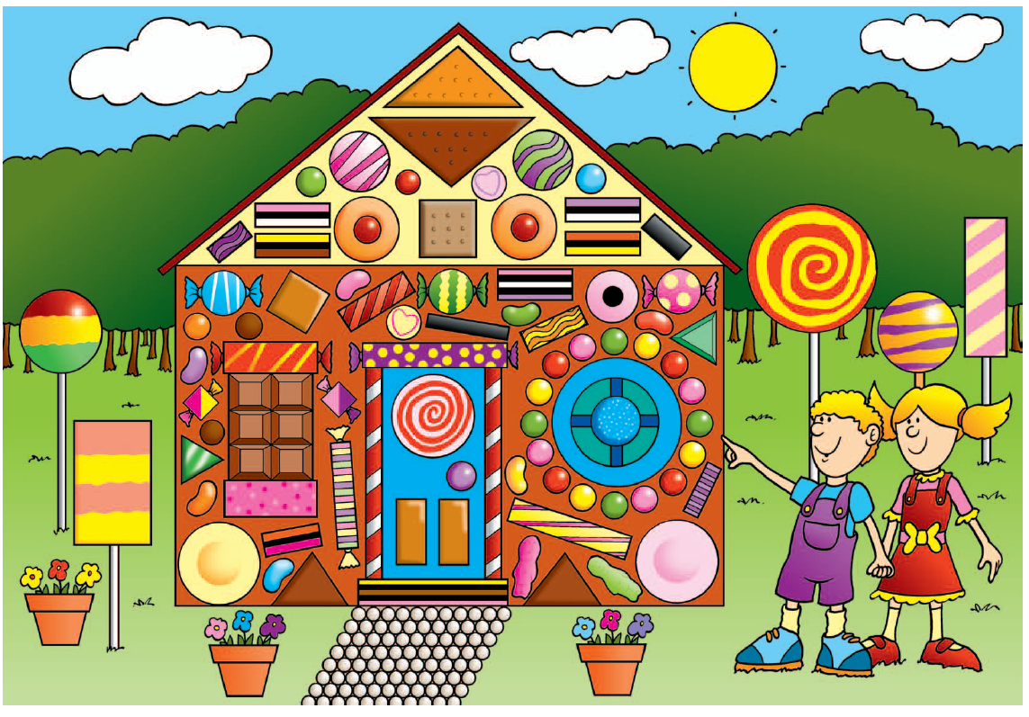
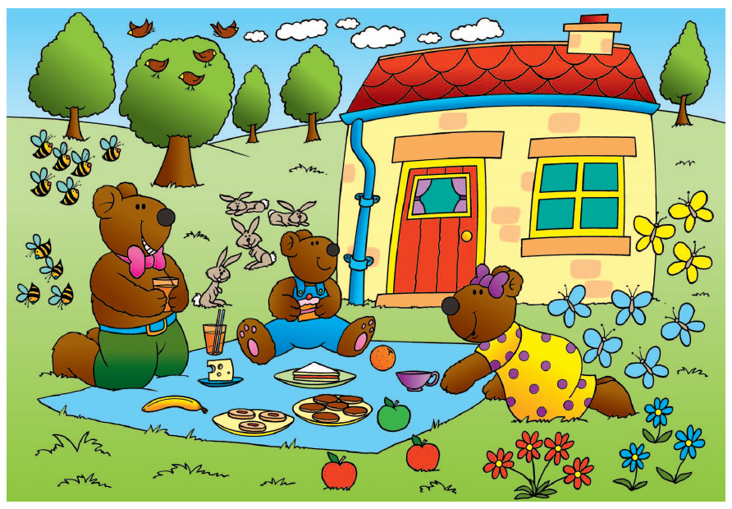
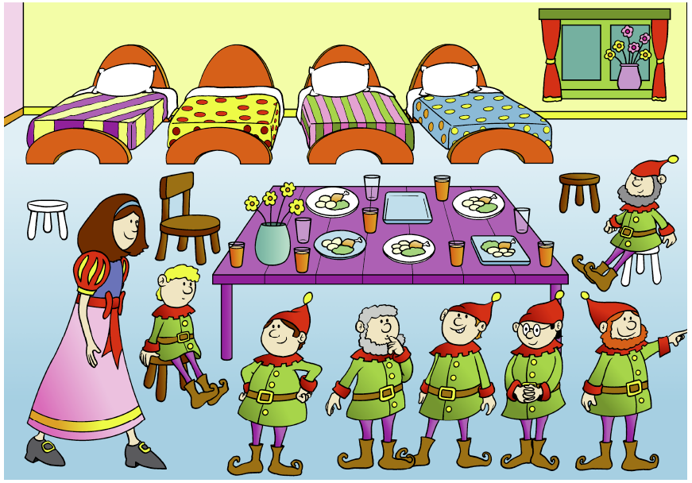
Notes:
Big Pictures to stimulate children’s talking. Ask parents what maths they can see in each picture.

Slide 10
How will children’s work be recorded?
Task sheets
Books
Videos
Photographs
Notes:
Adapt as necessary to suit your own school circumstances.

Slide 11
How can I become involved?
Talk to your child about their learning, what they learned in their maths lessons each day.
Discuss numbers all around you: door numbers, bus numbers etc.
Encourage your child to predict what number will come next in a sequence of door numbers – are they odd or even?
Cooking and shopping with your child, getting them to weigh ingredients, using language such as “more” and “less/fewer”.

