Slide 1
Key Stage 1
Curriculum Meeting
19/09/18

Slide 2
Key Stage 1 Teachers
Year 1
Heron – Miss. Pennington
Swan - Miss. Hussein
Flamingo – Miss. Attwood
Year 2
Peacock – Miss. Nagra
Kingfisher – Mrs. Nagra
Jay – Miss. McLaughlin
Key Stage 1 Leader- Mrs Keane
Year 1 Support Staff
Mrs. Brewster
Mrs. Allada
Miss. Coyle
Year 2 Support Staff
Mrs. Nijjar
Ms. Dickenson
Mrs. Jagatia

Slide 3



Year 1 Home Learning
Friday – English & Maths
(due Monday)
Friday- Talk Home Learning
Monday- Spellings (to be
tested on Friday)

Slide 4


Year 2 Home Learning
Monday – Spellings (To be tested Friday)
-Talk Home Learning
Friday – English & Maths (due Monday)

Slide 5

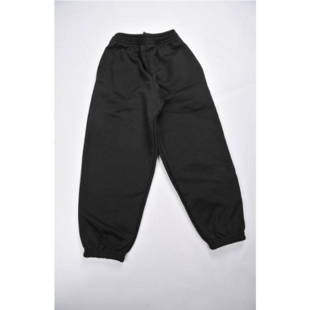

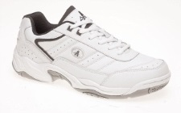
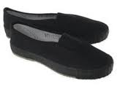
Physical Education
All children are expected to take part in P.E.
PE kit should be in school on correct days
School PE kits should be in all week, with plimsolls and trainers.
Year 1
Heron PE:
Monday (indoor) and Thursday (outdoor)
Swan PE:
Tuesday (indoor) and Thursday (outdoor)
Flamingo PE:
Friday (indoor) and Thursday (outdoor)
Year 2
Peacock PE:
Monday (outdoor) and Tuesday (indoor)
Jay PE:
Monday (outdoor) and Thursday (indoor)
Kingfisher PE:
Monday (outdoor) and Wednesday (indoor)

Slide 6


Reading
Reading log/record and reading book should be in daily, along with the diary planner.
Red – Year 1 Purple - Year 2
Children should be reading to an adult, for at least 20 minutes every evening.
Encourage asking and responding to questions using thinking skills.
When they have finished reading their book it will be changed in school. Please write finished when your child has finished the book as we will know then to change it. If your child is on Level 9 and above will be changed twice a week. (Monday and Friday)
Updating the Reading Record is necessary.

Slide 7
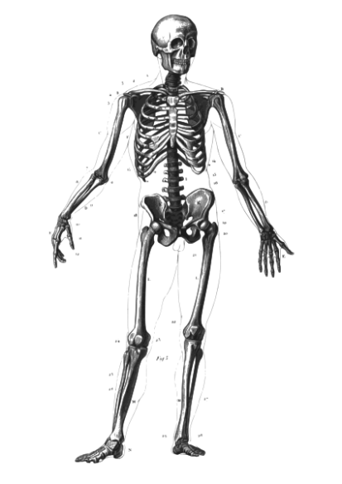

Topic Work
Creative Learning Journey
Year 1 -Who Am I?
- All Dressed Up
- Flowers and Insects
Year 2 -We Are What We Eat
-Live and Let Live
-Hooray Let’s Go On Holiday

Slide 8
Key Dates
Year 1 -Phonic Screening Check
June 2019
Year 2 -SATs
May 2019

Slide 9




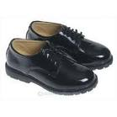

Uniform
Blue jumper or cardigan
Black trousers or skirt
White shirt or t-shirt
Black shoes
Accessories in blue, black or white (scarves & turbans)

Slide 10
Other
School starts at 8:45am and finishes at 3:30pm –All late pupils need to report to the office.
Home time procedures- Parents need to pick pupils up at 3:30pm.
Anyone who is not collected will be sent to the office.
If you need to see a teacher you can make an appointment at the office.
First point of contact is the class teacher, then Mrs. Keane, next Mrs Benton and finally Mr Tatters.

Slide 11

Questions

Slide 12

Thank you for attending
We look forward to working in partnership with you.

