Slide 1
Key Stage 1
Curriculum Meeting
20/09/17

Slide 2
Key Stage 1 Teachers
Year 1
Heron – Miss. Janjua
Swan - Miss. Warwick
Flamingo – Miss. Attwood
Year 2
Peacock – Miss. Nagra
Kingfisher – Mrs. Keane
Jay – Miss. Hardern
Key Stage 1 Leader- Mrs Keane

Slide 3



Year 1 Home Learning
Friday – English & Maths
(due Monday)
Friday- Talk Home Learning
Monday- Spellings (to be
tested on Friday)

Slide 4


Year 2 Home Learning
Monday – Spellings (To be tested Friday)
-Talk Home Learning
Friday – English & Maths (due Monday)

Slide 5


Reading
Reading log/record and reading book should be in daily, along with the diary planner.
Children should be reading to an adult, for at least 20 minutes every evening.
Encourage asking and responding to questions using thinking skills.
When they have finished reading their book it will be changed in school. Please write finished when your child has finished the book as we will know when to change it.
Updating the Reading Record is necessary.
Comments from parent and child please!
Parents must sign comments made by the child weekly.

Slide 6

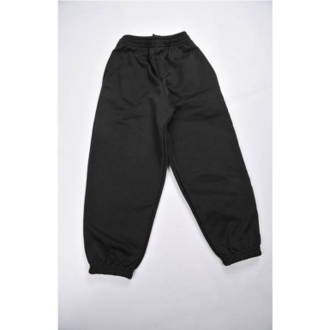


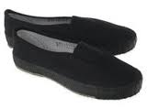
Physical Education
All children are expected to take part in P.E.
PE kit should be in school on correct days
School PE kits should be in all week, with plimsolls and trainers.
Year 1
Heron PE:
Heron (indoor) and Friday (outdoor)
Swan PE:
Thursday (indoor) and Thursday (outdoor)
Flamingo PE:
Monday (indoor) and Thursday (outdoor)
Year 2
Peacock PE:
Monday (outdoor) and Wednesday (indoor)
Jay PE:
Monday (outdoor) and Friday (indoor)
Kingfisher PE:
Monday (outdoor) and Thursday (indoor)

Slide 7
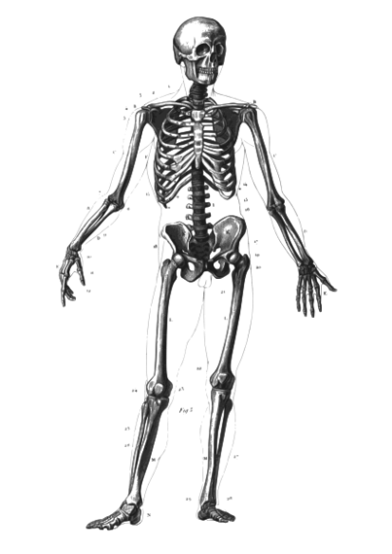

Topic Work
International Primary Curriculum
Year 1 -Who Am I?
- All Dressed Up
- Flowers and Insects
Year 2 -We Are What We Eat
-Live and Let Live
-Hooray Let’s Go On Holiday

Slide 8
Key Dates
Year 1 -Phonic Screening Check
June 2018
Year 2 -SATs
May 2018

Slide 9




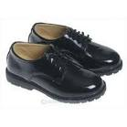

Uniform
Available to buy -Tuesdays and Thursdays from 2:45 to 3.15pm in reception (Mrs Churchill)
Blue jumper or cardigan
Black trousers or skirt
White shirt or t-shirt
Black shoes
Accessories in blue, black or white (scarves & turbans)

Slide 10
Other
School starts at 8:45am and finishes at 3:30pm –All late pupils need to report to the office
Home time procedures- Parents need to pick pupils up at 3:30pm
Anyone who is not collected will be sent to the office
If you need to see a teacher you can make an appointment in the office
First point of contact is the class teacher, then Mrs. Keane, next Mrs Benton and finally Mr Tatters

Slide 11

Questions

Slide 12

Thank you for attending
We look forward to working in partnership with you.

