Slide 1

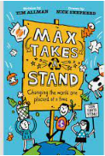
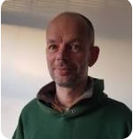
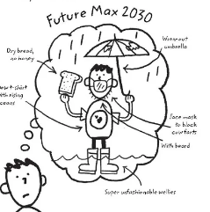

Year 5 English – Max Takes A Stand
Plot Summaryjjhjhjkhhhhhhhhhhhhdasjdajsssssss
Max is on a quest to make the world a better place. From hiding his parents’ car keys to preparing vegan dinners, Max is determined to help save the planet through positive direct action! But with hilarious and often disastrous results can Max’s enthusiasm pay off in the end?
A competition for schools making changes to help is an added incentive and Max sets about trying to win the competition for his school by encouraging his classmates, family and school to make changes that will help save the planet.
Name of Book:
Max Takes A Stand
Date Published: 2020
Author: Tim Allman
Genres: Children’s Fiction
Author: Tim Allman
Tim Allman graduated from Oxford University, became an environmental activist and is now an ethical, green builder. Max Takes a Stand is his first children's book.
Setting hhhhhhhhhhhhhhh jjhjhjkhhhhhbh
This story focus on Max’s plight to make the world a better place from his own home, to his school and the natural world around him.
Quotes j
“Max is on a mission to save the planet”
“What can you do to help stop climate change? LOTS”
“BRILLIANT PLANET SAVING IDEAS”
“Sometimes his bright ideas end in DIASTER, but he always learns by his mistakes.”
Key Vocabularyjdasldjaldjaljdlakjdlkajdljasssssbhbhjjjjjjjjjjj
vegan- a person who does not eat any food delivered from animals.
climate – the weather conditions over a long period of time.
climate change- a change in regional and global weather patterns
recyle – convert waste into reusable material
environment – the surroundings or conditions in which people or plants live
competition – the event or contest people take part in to try and win
disaster- a sudden accident or natural castastrophe
planet- earth: the planet in which we live as part of the solar system
mission- an important assignment given to a person or group of people
protest- to express objection to something that has been proposed
Main Charactersjdasldjaldjaljdlakjdlk ajdlb
Max - is a little boy on a mission to make the world a better place.

