Slide 1
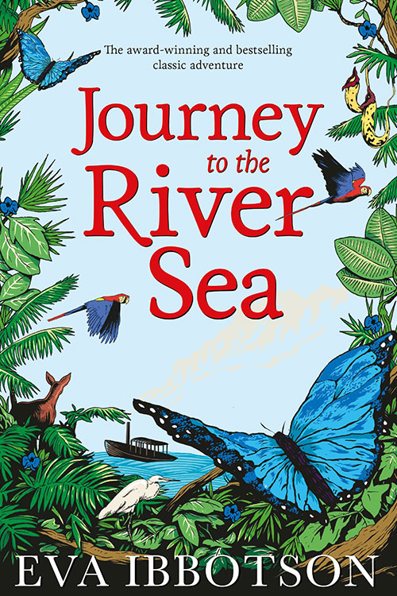
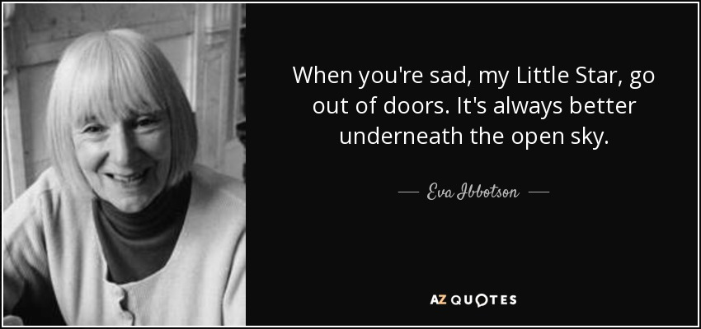
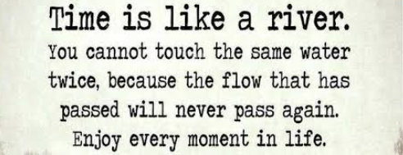
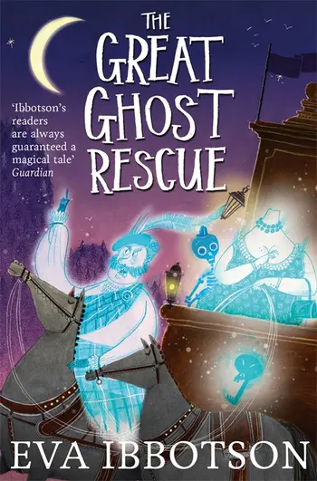
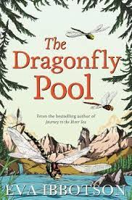
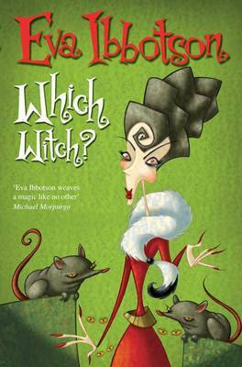
Year 5 English - Journey to the River Sea
Plot Summaryjjhjhjkhhhhhhhhhhhhdasjdaj sssssss
An Amazon adventure set in the wilderness of Brazil, Journey to the River Sea is filled with mystery and memorable characters. It is 1910 and Maia, tragically orphaned at thirteen, has been sent from England to start a new life with distant relatives in Manaus, hundreds of miles up the Amazon.
Name of Book:
Journey to the River Sea
Date Published:
Author: Eva Ibbotson
Genres:
Main Charactersjdasldjald jaljdlakjdlk
Maia Fielding - An orphan (Main Character)
Clovis King or Jimmy Bates or Lord Fauntleroy
Finn Taverner
Bernard Taverner
Mrs. Carter (first name not mentioned)
Mr. Clifford Carter
Miss Minton
Mr Trapwood
Mr Low
Key Vocabularyjdasldjaldjalj d Blackcaps - black raspberries
Decreed - declared, usually a legal declaration
Plunged - to fall into, often in water
Marauding - raiding villages to steal
Hillock - small mound
Weir - low dam that raised the water level in a river
Talisman - spirit guide
Sachem - Chief
Plunder - stealing by raid or attack
Setting jjhjhjkhhhhhhhhhhhhdasjdajss ssshh
Maia feels at home in the boarding school where she lives in London, in 1910. It is the only home she has known since her parents died two years earlier. When distant cousins are discovered 4,000 miles away, Maia must travel to the exotic Amazon River town of Manaus to live with them.
Quotesjk hkl kkhccc
What can the book teach us? s
The importance of embracing new experiences and of choosing your own outlook on life.

