Slide 1
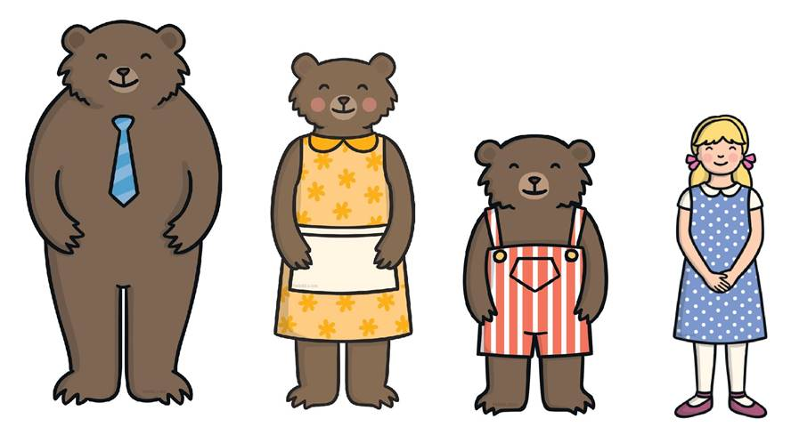

French – Boucle d’Or et les Trois Ours LI: To learn new language through picture, word and phrase cards.
Key Skills and Concepts
To learn to listen attentively to all of the familiar fairy tale in French and learn strategies to help decode longer pieces of spoken and written text that will contain unknown language. Learning to always look for cognates first and using picture, word and phrase cards for support.
Key Grammar
No explicit grammar point or structure is taught in this unit as it is a story telling unit working on language learning strategies.
Phonics
i = ee in = ah (nasal sound) ique = eek
ille = ee
i sound in petit, lit & il
ille sound in fille
Silent letters
‘S’ is not pronounced in boucles or fois
‘T’ is not pronounced in et or chat
Liaison
Ils ont. When a word ending in a normally silent consonant, like the ‘s’ in ils (which is normally silent) is followed by a word starting with a vowel as the ‘o’ in ont, the consonant ‘s’ is transferred onto the next word. It makes it very difficult to know where one word ends!
Key Vocab
les trois ours = the
three bears
Boucle d’Or =
Goldilocks
une maison = house
une fôret = forest
grand = big/tall/high
moyen = medium
petit = small
le bol = bowl
la chaise = chair
le lit = bed
sucré = sweet
salé = salty
basse = low
dur = hard
mur = soft
était trop = was too
(Le grand bol était trop salé = the big bowl was too salty)
était juste comme il faut = was just right
(Le petit lit était juste comme il faut = the little bed was just right
Expectations Listen attentively to a whole familiar fairy tale in French. Remembering new language using picture, word and phrases cards. Improve gist reading and gist listening skills. Attempt to re-tell a familiar fairy tale in French using a mini book for support.
Yr 5

