Slide 1
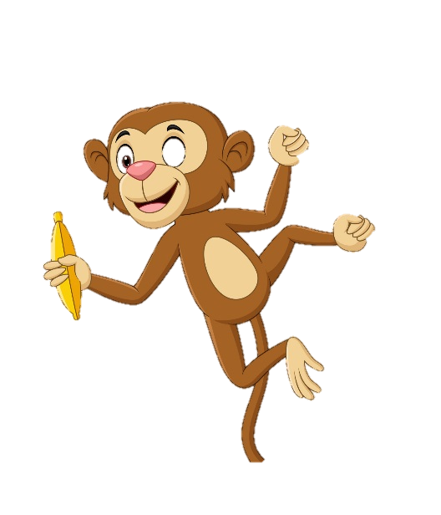

French – Les habitats LI: To speak and write about different habitats, plants and animals in French
Key Skills and Concepts
To continue to attempt and write longer more interesting sentences, that include a habitat, a plant and a relevant animal that lives in that habitat. Learning to manipulate the language therefore, being able to write a sequence of short sentences by the end of the unit showing increased linguistic knowledge and awareness.
Key Grammar
Verbs. Exploring the 3rd person
conjugation of the verb POUSSER (to
grow) and HABITER (to live).
je pousse j’habite
il/elle pousse il/elle habite
Phonics
é / É = ay e / E = uh è / È = eh
EAU = oh EUX = eu
é sound as in désert or océan
e sound as in le
eau sound as in chameau and eau
Silent letters
‘S’ is not pronounced in les, habitats or arbres
‘T’ is not pronounced in désert
Nasal sounds
Exploring the four French nasal sounds (on, un, in and an). This sound does not exist in English and is made through the nose not the mouth! Words like grands, dans, buissons, requin, national and singe.
Key Vocab
la forêt tropicale =
tropical rain forest
la prairie = meadow
l’océan = ocean
le désert = desert
l‘Arctique = the Arctic
le Sahara = the Sahara
l’Amazonie = the
Amazon
le chameau = camel
le lapin = rabbit
l‘ours blanc = polar
bear
le singe araignée = spider monkey
le requin = shark
les animaux et les plantes ont besoin de/d‘ = the animals and plants need
d'un abri = shelter
de nourriture = food
d‘air = air
de soleil = sun
d‘eau = water
Expectations
Say and write the key elements that animals and plants need to survive. Name the 5 most common types of habitats. Name an animal and a plant that live and grow in each type of habitat.
Yr 5

