Slide 1
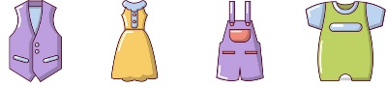
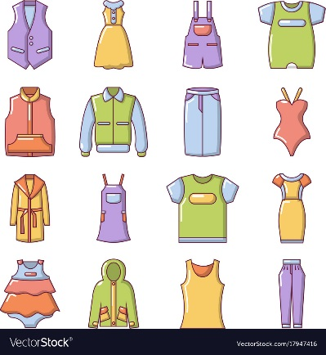

French – Les Vêtements LI: To describe what clothes you are wearing by colour in French.
Key Skills and Concepts To learn 21 nouns for clothes with their appropriate article. To explore the patterns in regular -er verb conjugation to enable us to say what we and possibly somebody else is wearing. To start to apply the rules connected to adjectival agreement correctly when describing items of clothing by colour creating more interesting, extended sentences.
Key Grammar Verbs, possessive adjectives, gender, definite, indefinite, partitive articles & adjectival agreement. The possessive adjectives for the word ‘my’ in French and gender of nouns will be revisited before the whole verb conjugation of the regular ‘er’ verb PORTER is introduced. Adjectival agreement is also revisited and extended using colours.
Phonics
é / É = ay e / E = uh è / È = eh
EAU = oh EUX = eu
é sound as in écharpe
e sound as in chemise
eau sound as in manteau
Silent letters
‘S’ is not pronounced in gants, sandales or vacances
‘ent’ is not pronounced in the 3rd person of the verb porter. This is the same for all present tense verbs.
Guttural ‘R’
Becoming more familiar with the French ‘r’ sound as seen in orange, rouge, robe, écharpe.
Made from the back of the mouth, not the front
Key Vocab
un pantalon =
trousers
un maillot de bain =
swimming costume
un pull = jumper
un tee shirt = t-shirt
un manteau = coat
un short = shorts
une robe = dress
une cravate = tie
une écharpe = scarf
une jupe = skirt
une veste = jacket
une chemise = shirt
une casquette = cap
des gants = gloves
des bottes = boots
des collants = tights
des sandales = sandals
des lunettes = glasses
un chemisier = blouse
des chaussures = shoes
des chaussettes = socks
je porte = I wear
mon = my (masc sing)
ma = my (fem sing)
mes = my (plural)
Expectations Recognise and recall from memory 21 items of clothing. Explore the regular ‘er’ whole verb present tense conjugation of the verb PORTER to describe what you and possibly somebody else is wearing. Revisit the use of the possessive adjective ‘my’ in French and describe clothes in terms of colour
Yr 5

