Slide 1
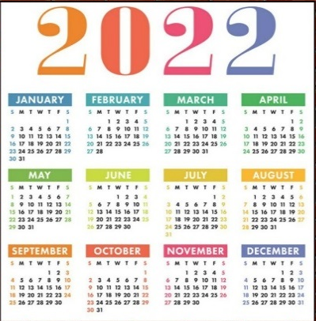

French – Quelle est la date? LI: To be able to say the date in French
Key Grammar
Ordinal & cardinal numbers. To learn that months
of the year (and days of the week) do not have a
capital letter in French unless they are found at the start of a sentence. The only ordinal number for saying the date in French is the 1st (premier) after that only cardinal numbers are used. No 2nd, 3rd , 4th etc.
Key Skills and Concepts
To learn how to formulate the date in French and use this knowledge to say when our birthday is using days of the week, months of the year and numbers 1-31.
Key Vocab
lundi = Monday
mardi = Tuesday
mercredi = Wednesday
jeudi = Thursday
vendredi = Friday
samedi = Saturday
dimanche = Sunday
janvier = January
février = February
mars = March
mai = May
juin = June
juillet = July
Phonics
é / É = ay e / E = uh è / È = eh
EAU = oh EUX = eu
Silent letters
‘S’ is not pronounced in mars
‘T’ is not pronounced in est or juillet
Guttural ‘R’
Becoming more familiar with the French ‘r’ sound as seen in mardi & mercredi.
Made from the back of the mouth, not the front
août = August
septembre = September
octobre = October
novembre = November
décembre = December
C’est quand ton anniversaire? = When is your birthday?
Mon anniversaire est = My birthday is
Expectations
At the end of the unit you will be able to recognise and recall the 12 months of the year in French. Ask what the date is and say the date in French. Ask somebody when their birthday is and say when their own birthday is in French.
Yr 5

