Slide 1
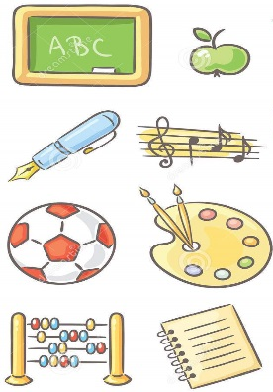

French – À l’École LI: To discuss what subjects you like and do not like at school and give a reason why in French.
Key Skills and Concepts To be able to provide positive and negative opinions and justifications to questions on school subjects and learn that these opinions and justifications are transferable language and can be used in other topics, not just as responses to questions asked in the school topic. Learning how to extend our sentences, making them longer and more interesting.
Key Grammar Nouns, gender, definite articles & high frequency regular verb étudier. Revision of definite article le, la, l’ and les. Focus on 1st person singular conjugation of verb étudier with an opportunity to explore the whole verb conjugation. Learning how to also use opinions and justifications.
Phonics
qu = k ç = s an = on (nasal)
gne = nyuh en = on (nasal)
QU sound as in informatique & musique
Ç sound as in français
AN sound as in anglaise, français, amusant & intéressant EN sound as in sciences
Silent letters
‘s’ is not pronounced in aimes
‘t’ is not pronounced in sport
‘x’ is not pronounced in ennuyeux
Elision
J’étudie. Dropping of the last letter of a word (in this case the ‘e’ in je) and replacing it with an apostrophe.
Key Vocab
à l’école = at school
le français = French
l‘anglais = English
le dessin = Art
le sport = PE
la musique = Music
la géographie =
Geography
l‘histoire = History
les maths = Maths
les sciences = Science
l‘informatique = ICT
j’aime = I like
j‘adore = I love
je n’aime pas = I don’t like
je déteste = I hate
amusant = fun
utile = useful
intéressant = interesting
facile = easy
ennuyeux = boring
difficile = difficult
inutile = pointless
parce que = because
et = and
c‘est = it is
Expectations Name the subjects we study in school in French with the correct definite article/determiner. Extend sentences by giving an opinion and extend even further by giving a justification. Start to tell the time by learning how to say time by the hour. Say at what time we study certain subjects at school.
Yr 5

