Slide 1

Upper Key Stage 2 Curriculum Meeting
20.09.2022

Slide 2
Upper Key Stage 2 Teachers
Year 5
Eagle – Ms Mohammed / Mrs Honeghan-Bates
Hawk – Mrs Shaikh / Mrs Chohan
Osprey – Mr Lillie
Year 6
Falcon – Mrs Simpson
Harrier – Mr Maynard
Kestrel – Ms Duong
Deputy Headteacher / SENCO / Phase Leader - Mrs Benton

Slide 3
Upper Key Stage 2 Support Staff
Year 5
Mrs Harrish
Mrs
Year 6
Mrs Petruk (HLTA)
Mrs Chana
Mrs Jan

Slide 4

Westbrook Vision…
Aims – children to:
Be creative learners who are inspired to think and investigate
develop and apply skills and knowledge which equips them for life-long learning
learn and apply skills/knowledge through first-hand experiences
Be proud of their learning and aim to achieve their best
believe in the value of team work, helping and caring for one another
Staff, Governors and the whole community are ambitious and seek to provide only the very best education for our children

Slide 5
Westbrook Vision…
Aims
We will achieve our aims by:
Teaching life skills to the children and involving parents
Providing opportunities for parents and the community to participate in the life of the school
Celebrating achievement and success (rewards, assemblies etc.)
Participating in community events (sporting, learning etc.)
Embedding and apply thinking skills throughout the curriculum
Providing a curriculum which is broad and balanced which also encourages: resilience, confidence, independence, inclusivity, creative thinking and enquiry

Slide 6
The curriculum…
Assessing:
Children are assessed every term in core subjects, including SPaG
We use the following terms:
Commencing, Developing, Expected, Mastery (Greater Depth)
Children are targeted to move from Commencing for the year group to Expected by the end of the academic year.

Slide 7
End of KS2 Assessments
Written tests in:
Reading
Maths
Spelling, Grammar & Punctuation
Teacher Assessment:
Writing assessed over time
SATs – Week commencing 08/05/2023
SATs Meeting will be held closer to the assessment period for parents of children in Year 6

Slide 8



English - reading
All children should be reading everyday
Their reading books should brought to school and taken home everyday (levelled book, book of their choice and from Wonder World)
Record comments about your child’s reading electronically on Boom Reader (see next few slides)
Children should also be recording comments about the books that they read
Encourage children to read for enjoyment and e.g. fiction and non-fiction texts
Encourage your child to read when out and about e.g. road signs, menus, food packaging
Visit the local library in Heston

Slide 9

Boom Reader!
Westbrook Primary School we will be using online Reading Records through the website & app called ‘Boom Reader.’ This will form your child’s digital reading record; no more paper reading records!
-Comments by yourself and from your child can be written via the website / app about their reading and the teacher is able to respond, comment and create questions too.
- The children will be able to create their own reading character and they can earn lots of reading gems too from their teacher depending on how much they read.

Slide 10
Boom Reader!
Children should be reading to an adult, for at least 20 minutes every evening.
Log all reading on the app, even if you do not complete the book.
Encourage asking and responding to questions using thinking skills.
Books should be bought into school each day, regardless if read of not in the plastic reading wallet.
Books will not be changed until the ‘Book Complete’ tab has been tapped on the parent app.
As you become more confident in using the app, please begin to write pupil and parent comments.

Slide 11
Boom Reader!
Boom Reader Workshops – school hall
EYFS & KS1= Wednesday 12th October 2022 - 9.15am
KS2 = Thursday 13th October 2022 – 9.15am

Slide 12

Destination Reader
Destination Reader is an approach to teaching reading in KS2. It involves daily sessions incorporating whole class modelling prior to the children applying these skills through partner work and independent reading.
Skills include: predicting, inferring,
evaluating, clarifying and
summarising

Slide 13
KS2 (English - Writing)
Year 6:
Word
Vocabulary typical of informal speech and vocabulary appropriate for formal speech and writing
Recognition and application of synonyms and antonyms [for example, big, large, little]
Sentence
Use of the passive voice
The difference between structures typical of informal speech and formal speech in writing

Slide 14
Writing
Text
Linking ideas across paragraphs
repetition of a word or phrase, grammatical connections [for example, the use of adverbials
Layout devices [e.g. headings, sub-headings, columns, bullets, or tables]
Punctuation
Use of the semi-colon, colon and dash
Use of the colon to introduce a list and use of semi-colons within lists
How hyphens can be used to avoid ambiguity [for example, man eating shark versus man-eating shark, or recover versus re-cover]
Terminology for pupils
subject, object
active, passive
synonym, antonym
ellipsis, hyphen, colon, semi-colon, bullet points

Slide 15
Writing

Slide 16
Writing…
Big Writing lessons completed on a weekly basis (mostly) to give the children lots of experience of writing at length independently
Please support your child by discussing the subject or scenario given for Big Talk home-learning. We will be sending home examples of the outcome to support parents with this

Slide 17


Maths (mastery approach)…
Number (place value, + - x ÷, fractions)
Measurement (volume, converting units)
Geometry (Properties of shapes, position and direction)
Statistics (interpreting information in tables)
In addition, Year 6 learn about:
Ratio and proportion
Algebra

Slide 18
Maths…
Children will be set termly targets in maths linked to the National Curriculum.
These will be written in the home-learning diaries for you to see

Slide 19
Westbrook Wonder World Curriculum……
key elements of the teaching in all subject areas incorporates Thinking Skills and hands-on experiences.
We hope to ensure the children are developing ‘in-depth’ knowledge in each subject area
We teach the subjects separately and follow the National Curriculum
All the subject specific units will begin with an exciting Entry Point to hook the children into the new unit. Followed by a ‘Knowledge Harvest’ lesson to assess their prior knowledge and then discuss what they want to learn. This is then used to plan the half term lessons using our ‘thinking skills’ techniques and approaches. At the end of each unit, an Exit Point will take place as a chance to celebrate all the learning.

Slide 20
Westbrook Wonder World Curriculum…
 |  | Autumn Term
Year 5 | Science | Life cycles; Earth & Space
 | History | Anglo-Saxons
 | Geography | Changes in the Local Environment
 | Art | Chinese Art
 | DT | Chinese Interventions
 | Music | Livin’ on a prayer, Jazz
Year 6 | Science | Our bodies; Light & Sound
 | History | The impact of WWI & WWII
 | Geography | Global Warming
 | Art | Gustav Klimt
 | DT | Great British Dishes
 | Music | Pulse and rhythm

Slide 21





Key Texts…
 | Autumn | Spring | Summer
Year 5 | Max Takes a Stand | Wonder | Journey to the River Sea
Year 6 | Goodnight Mister Tom | Skellig | The Boy at the Back of the Class

Slide 22
Home-learning
Your child will be set a range of home-learning activities throughout the week that need to be completed and submitted to their Google classroom
Home-learning is very important as it allows your child to consolidate what they have been learning in class
Please support your child to complete their home-learning and discuss with them what they have been doing at school
Help to create a suitable environment for completing home-learning and try to establish a routine
Home-learning diaries – targets, home-school agreement

Slide 23




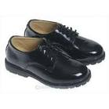

Uniform
The royal blue uniform is available from www.yourschooluniform.com
Blue jumper or cardigan
Black trousers or skirt
White shirt or t-shirt
Black shoes
Accessories in blue, black or white

Slide 24
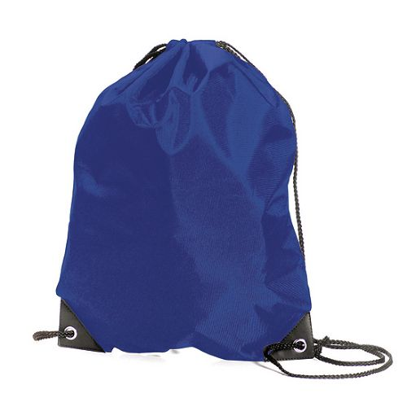
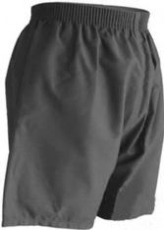
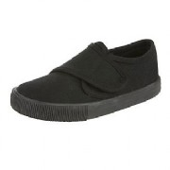
Physical Education
* Please ensure that your child wears the correct PE kit to school on the specified days
* No jewellery for safety reasons
* Long hair to be tied back
* Correct footwear that fits
* Trainers can be worn for outdoor lessons

Slide 25
PE
P.E. Days
Eagle – Tuesday (swimming) & Wednesday
Hawk – Wednesday (swimming) & Thursday
Osprey - Thursday (swimming) & Tuesday
Falcon – Tuesday & Thursday
Harrier – Friday & Thursday
Kestrel - Wednesday & Thursday

Slide 26

Collection of children
Please also let us know if you are not going to be collecting your child at the end of the day (3.25pm) and tell us the name of the person who is (write a letter, speak to the class teacher or inform the office)
If another grown-up is going to collect your child on a regular basis we also need to have this in writing
Older siblings are not allowed to collect your child unless they are over 16.
If possible, try to introduce the person, who is going to collect your child, to the class teacher beforehand
Please give written permission if you allow your child to walk home from school (Y5 & 6)

Slide 27
Attendance
Please ensure children are in school on time.
The gates open at 8:30am and close at 8:50am.
Please supervise your child whilst in the playground before registration and after school at the end of the day
Good attendance is very important to maintain consistency in learning patterns and for children to progress. We are working very hard at Westbrook to ensure that our rates of attendance are as high as possible and above the national average of 96%
Year 6 are coming into school for 8:00am to support their studies for the SATs (w/c 26/09/2022)

Slide 28

Birthday Books…
If you would like to mark your child’s birthday, we would ask that you donate a book to your child’s class library rather than bringing in food items for the class. Your child will be able to share this book with the class before adding it to the class library. If you have a book to donate please see the office for one of our special labels to put inside.

Slide 29
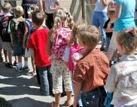
Independence…
As your children grow older, the more independent they will become. It is vital that children gain the experience of being responsible for their own things. It would be extremely helpful if children come into school, with all their belongings ready to start the school day e.g. bookbag, home-learning diary & water bottle.

Slide 30
Sharing information…
Please ensure that we have the correct contact details including changes to mobile numbers and email addresses (give these to the school office)
Google classroom – please speak to the class teacher if you have any problems turning in learning

Slide 31
Extra information…
Please fill out the Free School Meal application forms online if you think you might be eligible
Breakfast and After-school Clubs –
They will be delivering different physical activity sessions during lesson time and lunch time.

Slide 32


Thank you for attending the Upper Key Stage 2 Curriculum meeting.
We look forward to working in partnership with you.
Please feel free to ask staff any questions you may have.

