Slide 1


Slide 2

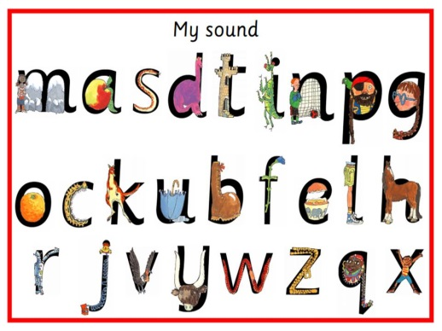
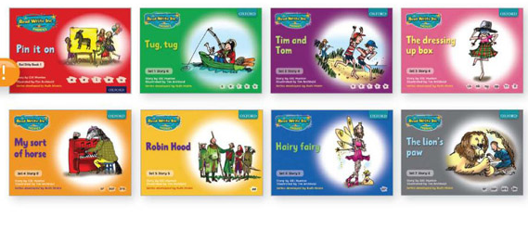
Phonics program we follow.
Children learn letter sounds. When they are ready and are blending words we begin to introduce story books during our sessions.(Ruth Miskin Read Write Inc)
Please watch this short video which will show you how we teach the sounds
https://www.oxfordowl.co.uk/for-home/reading-owl/find-a-book/read-write-inc-phonics--1/phonics-pure-sounds-video

Slide 3

Children will eventually be split into groups depending on their learning needs.
We teach children letter sounds with a picture hook. Each picture has a handwriting phrase.
You will find more information here to help you
https://home.oxfordowl.co.uk/reading/reading-schemes-oxford-levels/read-write-inc-phonics-guide/#set1
Notes:
The sounds you see above are from set 1 which we have started work on this week. We will cover set 1, 2 and 3 sounds depending on your child’s ability.

Slide 4


This is Fred
Fred helps us to sound out words. We talk to the children about Fred talk ‘b-a-t’ and real talk ‘bat’
We also talk to the children about using Fred fingers to count out the sounds we hear in a word and pinch our fingers as we say them.

Slide 5

Introducing books
Children will be linking their learning to key books when they are able to read simple words independently e.g. pin, pot, hat.
This is an extension of the phonics lesson.
Children will work on saying a sentence, remembering it, then writing it independently. These will also be simple and match phonic knowledge.

Slide 6
If you have any questions about Read Write Inc please email us
Barn Owl Class – Ms Janjua
t.janjua@westbrookprimary.co.uk
Snowy Owl Class – Mrs Presepi
s.presepi@westbrookprimary.co.uk
Tawny Owl Class – Ms Balaban
e.balaban@westbrookprimary.co.uk

