Slide 1

Welcome to Nursery’s Curriculum Meeting

Slide 2



Introducing the team.
Mrs Lewis
Nursery Teacher
Mrs Lawrence
Nursery Nurse
Miss Wetton
Nursery Assisstant

Slide 3
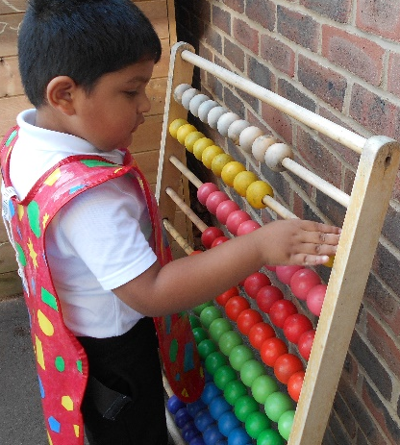
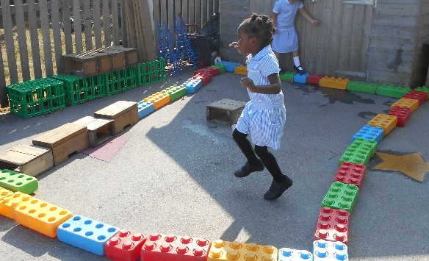
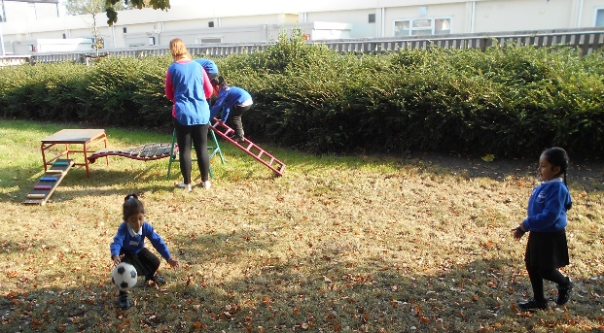
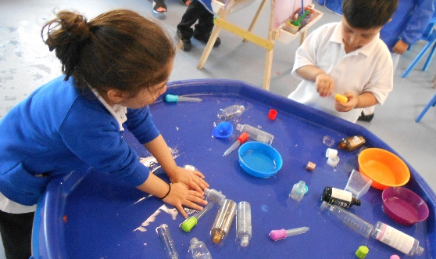
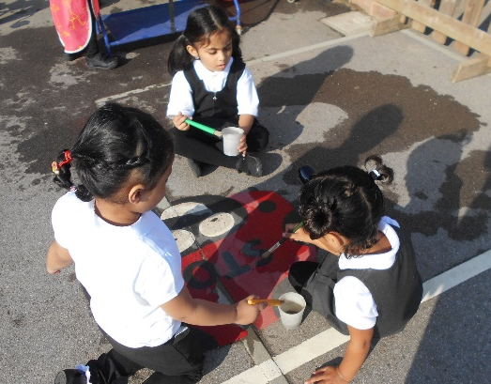
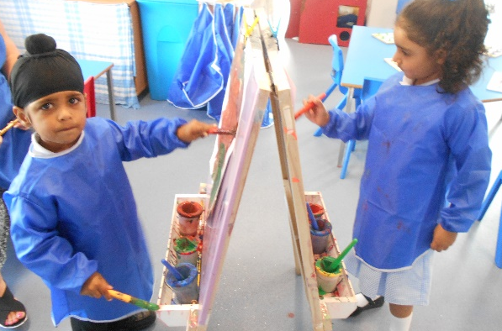
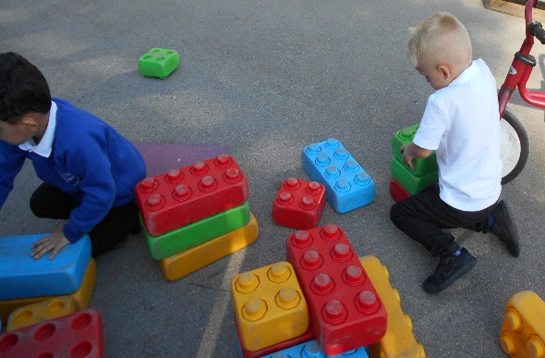
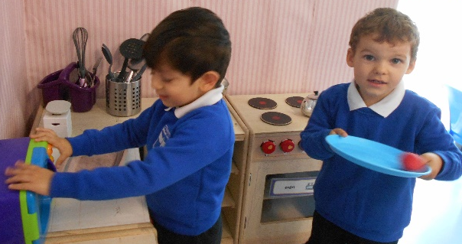
We have really enjoyed getting to know your children over the last few weeks.
In nursery we learn through play, and we have been very busy learning.

Slide 4


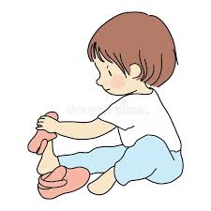

Helping your child to be independent.
Encourage your child to take off and put on their coat themselves.
Encourage your child to use the toilet. And to ask for help when they need it.
Encourage your child to take off and put on their shoes themselves.
Encourage your child to come to tell an adult if they are upset or hurt.

Slide 5

Development matters
All children up to the end of their reception year follow the EYFS Curriculum whatever setting they are in.

Slide 6

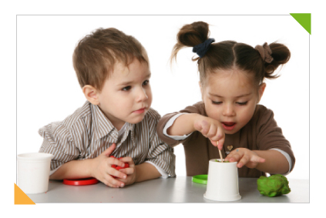
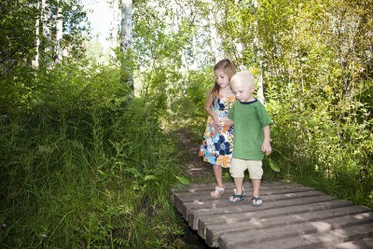
Effective Learning
In nursery activities are set up to involve effective learning.
Playing and exploring
Active independent learning
Being independent and choosing for themselves
Creating and thinking critically

Slide 7
EYFS Curriculum
The EYFS curriculum is split in to 7 areas.
Prime areas
Personal, Social and Emotional development
Communication and language
Physical Development
Specific areas
Literacy
Mathematics
Understanding the world
Expressive arts and design

Slide 8
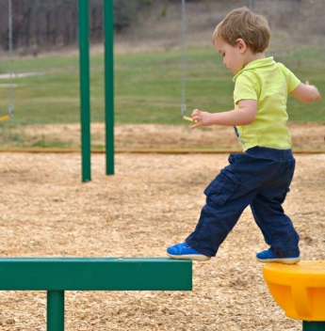
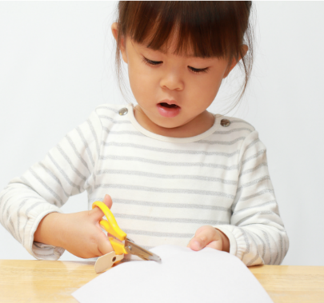
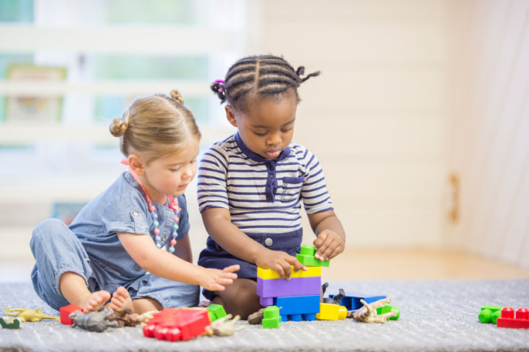
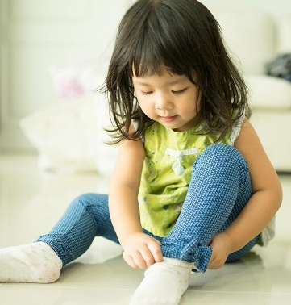



What does this look like in Nursery
Prime areas
PSED
Children playing together
Sharing
Waiting, taking turns
Talking to each other.
Physical Development
Climbing, running, jumping,
Using scissors and mark making tools.
Independence skills such as dressing
Communication and Language
Listening and responding to stories
Joining in with songs
Talking to others
Responding to and asking questions

Slide 9
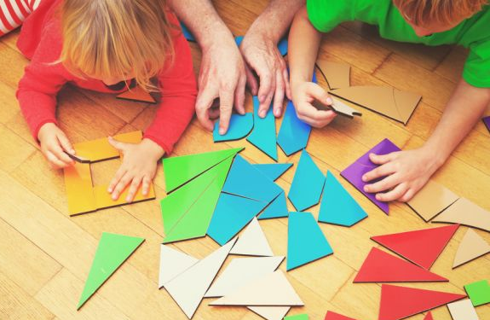
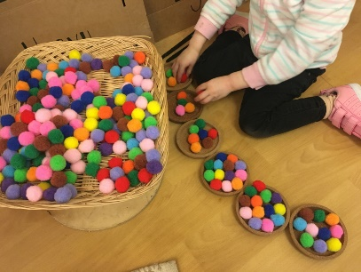
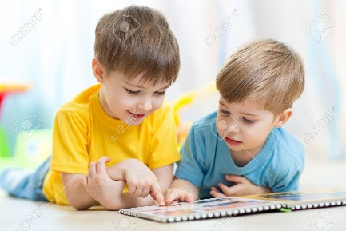
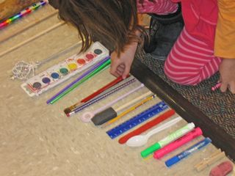
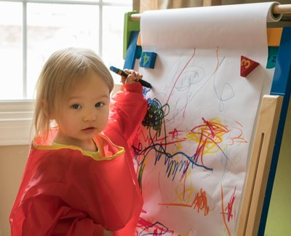
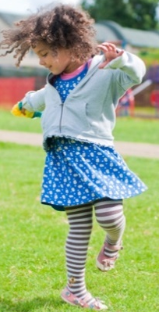
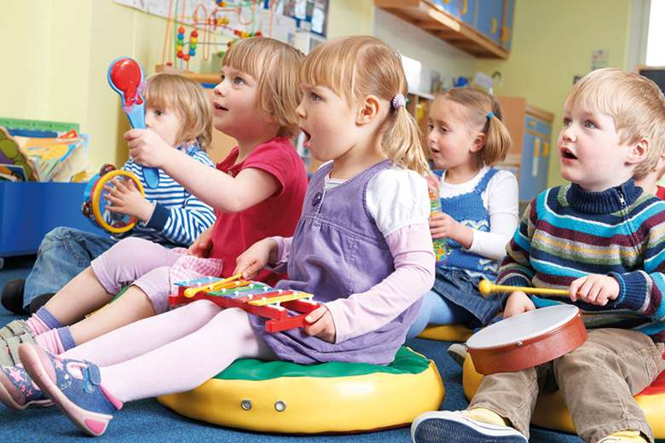
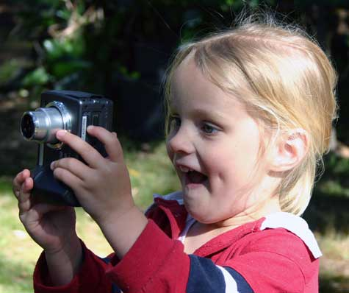
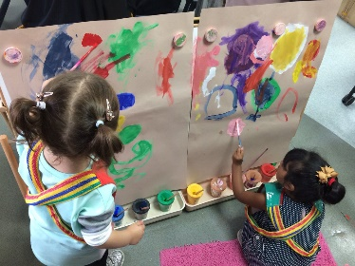
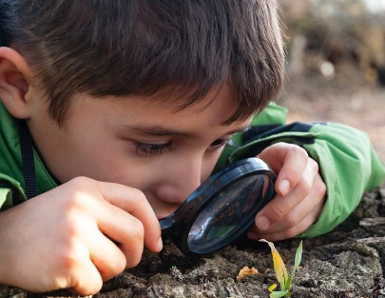
What does this look like in Nursery
Specific areas
Literacy
Enjoying books
Listening to and making up stories
Talking about stories
Making marks and talking about what they mean
Mathematical Development
Counting
comparing
describing
Using and exploring materials
Dancing
Making music
Painting
Role play
Understanding the World
Using technology
Exploring
Asking questions

Slide 10



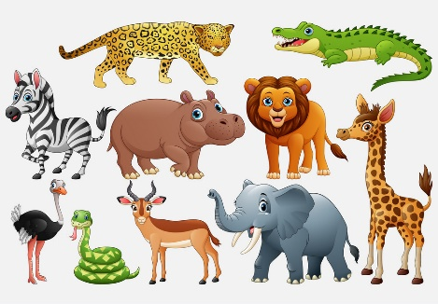

Topic based learning
Once Upon a Time
Marvellous Me
Super Heroes
Animals
Under the Sea

Slide 11
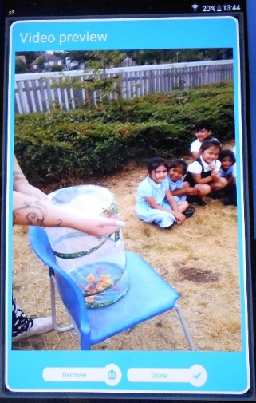
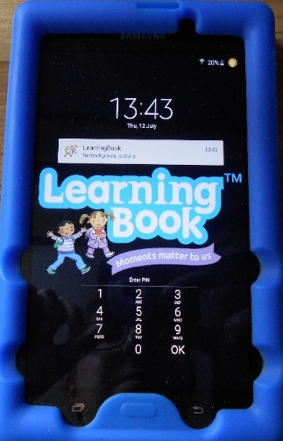
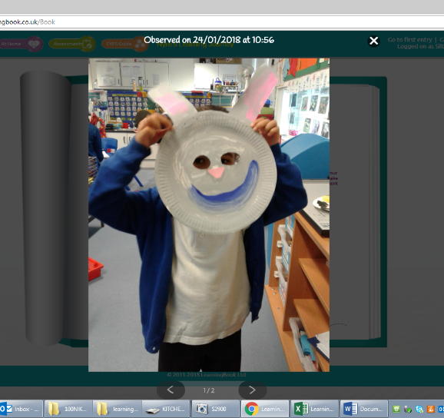
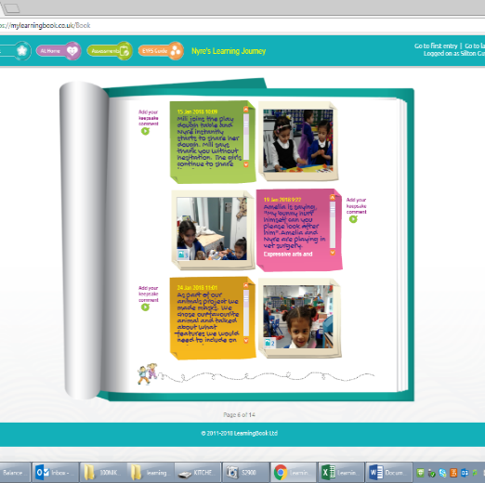
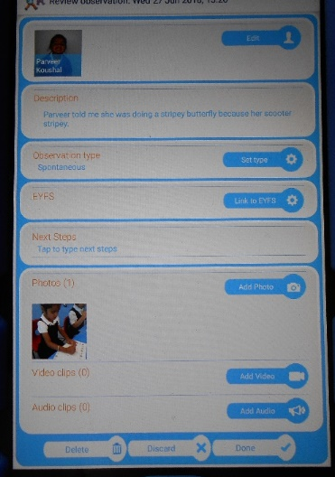
Tracking your child’s learning
We can take videos and pictures of the learning taking place.
We use a program called learning book. These are the tablets we use to capture your child’s learning.
We then add our assessment of how that observation links to the learning objectives in the nursery
You get a personal log in to use at home. You can see all the exciting/fun learning your child has done.
You can click on an image in the learning journal to enlarge it

Slide 12

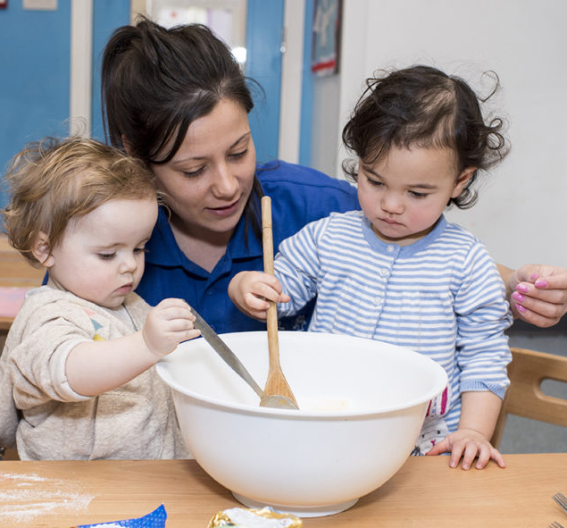


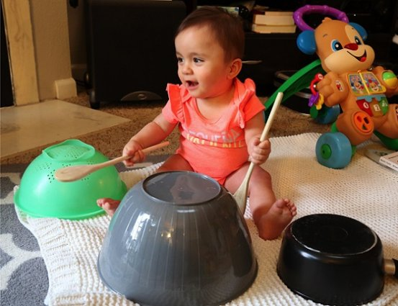
How can I help at home.
Limit screen time .turnoff the TV when not being watched.
Involve your child in helping with cooking talk about what you are doing count how many eggs etc you are using
Share books with your child.
Toys don’t need to be expensive.

Slide 13
Thank you
For being on time at the start and the end of the session
For bringing your child’s water bottle everyday
For sending a pair of wellies into school
For putting your child’s name on EVERYTHING
For working in partnership with us to settle your child
For asking about your child’s settling after the session when we have more time

