Slide 1

Reception Class
Keeping Healthy

Slide 2
We are going to learn about…
Staying Healthy!
Looking After Yourself!
Growing Up & Learning New Things!

Slide 3
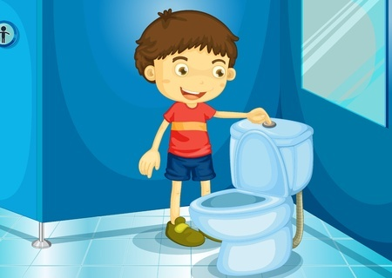
When I start school I will try to be able to…
…know when I need the toilet and be able to use the toilet on my own!

Slide 4
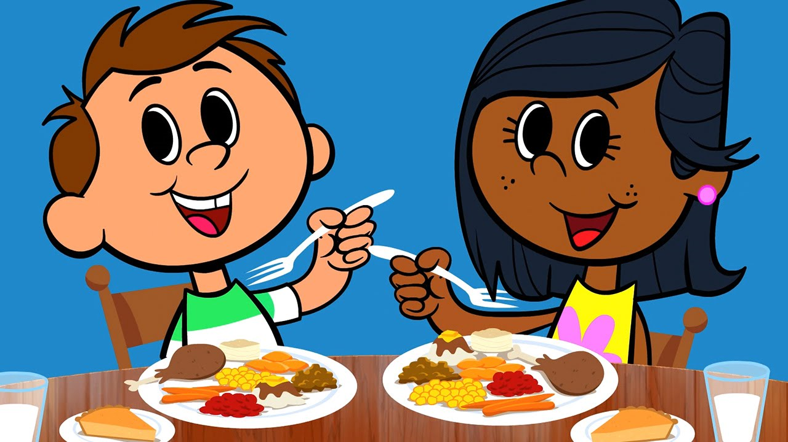
When I start school I will try to be able to…
…feed my self at meal time!

Slide 5
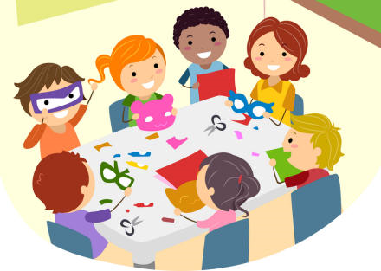
When I start school I will try to be able to…
…take turns, sit nicely, listen and play with friends!

Slide 6
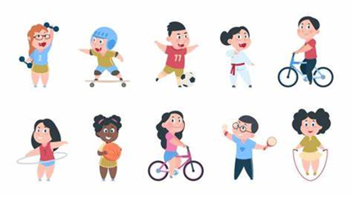
When I start school I will try to be able to…
…be active and learn to run, hop, skip, jump and balance!

Slide 7
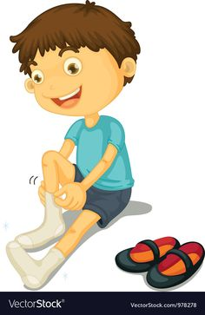
When I start school I will try to be able to…
…get dressed and put my shoes on without needing help!

Slide 8
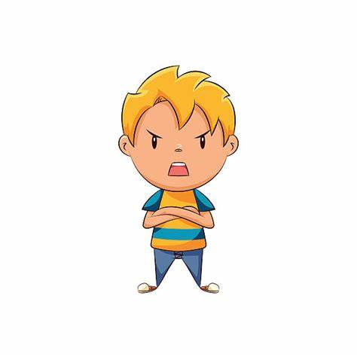
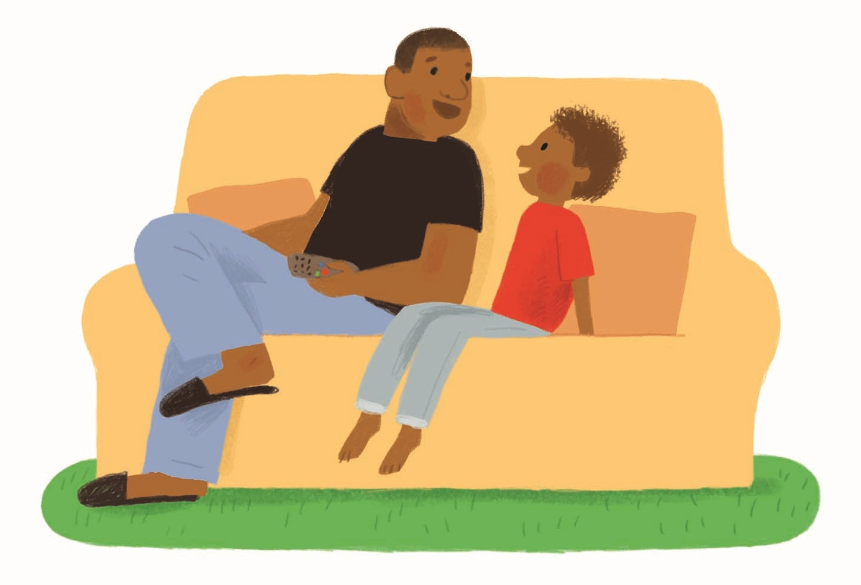
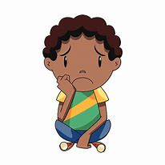
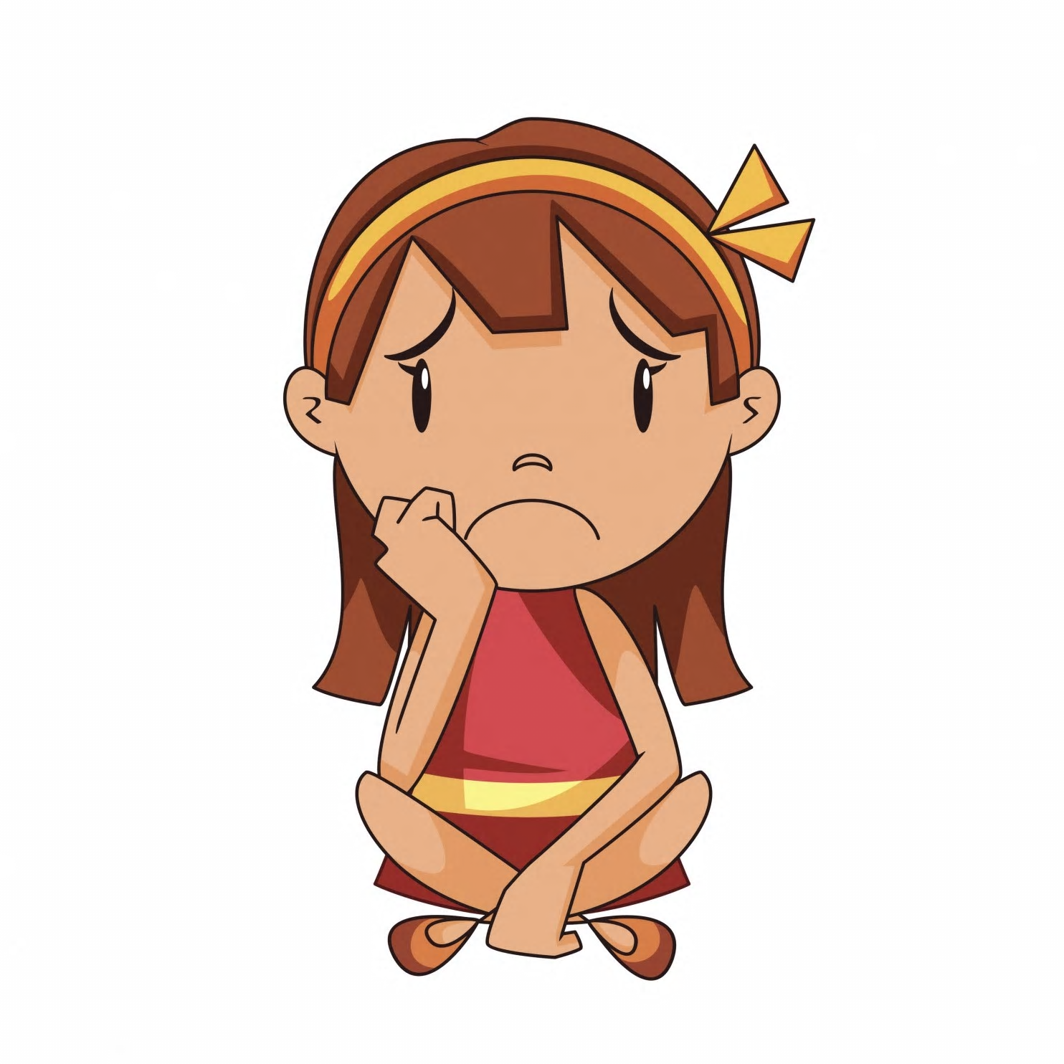
If I am sad, worried or upset I will…
…try to use my words to tell an adult how I feel and what help I need!

Slide 9
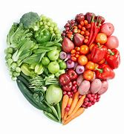
I will try my best to have a healthy diet…
- Eat lots of fruit & vegetables
- Drink lots of water
- Eat meals together at home
- Eat less of the foods that have lots of sugar and fat in like cakes, biscuits, crisps, take-aways & sweets
- Do not drink fizzy drinks

Slide 10

I will be active…
- Keep moving!
- Try new things!
Being physically active is good for your body and helps you feel good too!

Slide 11
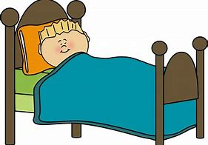
I will make sure I get enough sleep…
- You need around 11 hours of sleep a night!
- Have a bedtime routine that helps you feel relaxed and ready for bed.
TV, phones, tablets and PlayStation / Xbox should not be in the bedroom or used before bedtime.
- Try not to have a drink before bedtime.

Slide 12

I will talk to an adult if…
…I feel sad, upset, worried or uncomfortable with anything someone else has said or done.

Slide 13

I will look after my teeth…
- Brush your teeth 2 times a day for 2 minutes.
- Visit the dentist at least once a year for a check-up (even if you don’t have any problems with your teeth).
- Try not to have too many sugary drinks or foods.
- No more dummies, bottles or sucking thumbs as this is not good for your teeth.

Slide 14
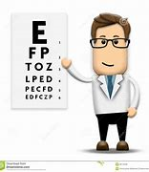
I will look after my eyes…
- Have your eyes checked at the opticians.
- Take part when the school nurses come into school to check your vision.
If you have headaches or problems seeing the letters in a book or on the white board let an adult know.

Slide 15
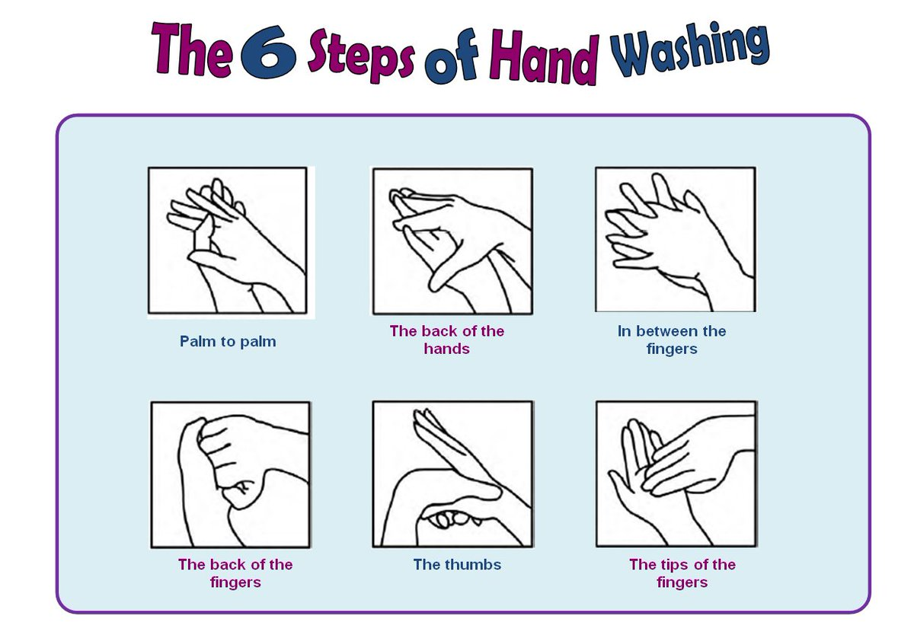
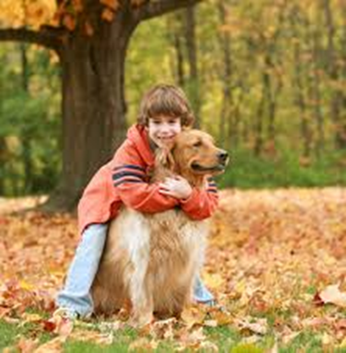
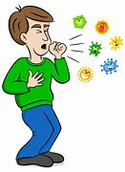
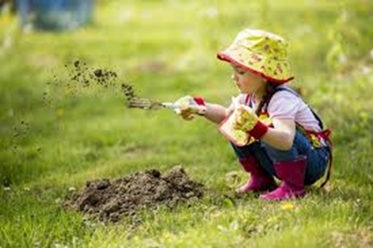
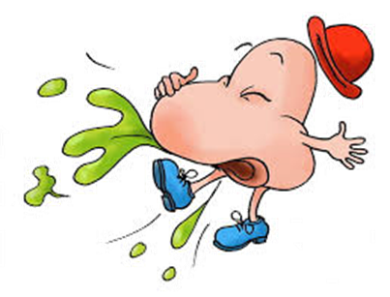

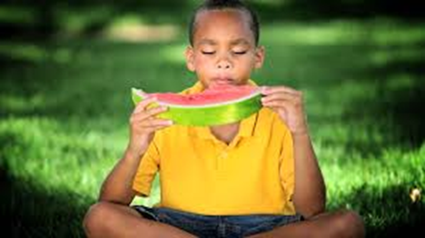
I will keep my hands clean…
Don’t forget to wash your hands when…

Slide 16
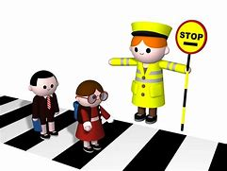

I will try to keep myself safe…
- Wear sun lotion
- Drink plenty of water
- Stay in the shade
Wear a helmet if you are on your bike or scooter.
- Hold an adult’s hand to cross the road.
- STOP, LOOK, LISTEN, THINK before crossing the road.

Slide 17

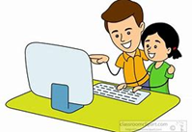
I will try to keep myself safe…
Never go anywhere with someone you don’t know. Stay with your grown-up.
- If a stranger makes you feel unsafe - Yell & Tell!
- Show your grown-ups what you are playing online and tell them if anything upsets you.
- Do not tell strangers your name, where you live or where you go to school (in real life or online).
- Don’t accept gifts or treats from strangers.

Slide 18
Can you tell me…
When should you wash your hands?
What will you do if you if you feel upset or worried?
How many times should you clean your teeth each day?
Can you remember 3 things you will try to be able to do when you start school?
What is the healthiest drink to have?

Slide 19


Any Questions?
Thank you
from the Hounslow School Nurses

