Slide 1
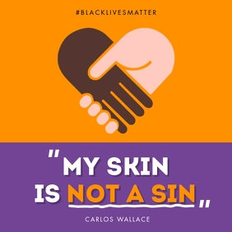
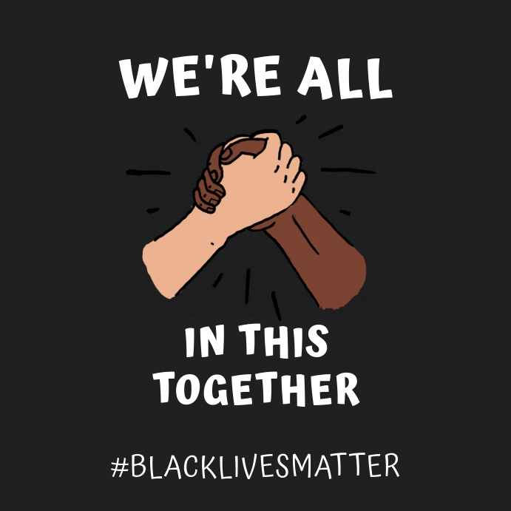
BLACK LIVES MATTER:
What is the term black lives matter?
Black lives matter is a protest to encourage others that black people should be treated fairly.
It doesn’t matter what skin color you are!!! You should always BE PROUD of who you are even if you don’t fit in.
If you see someone being treated horribly because of their skin color or religion, you should stand up for them. WE ARE ALL IN THIS TOGETHER!!!! WE SHOULD SUPPORT ONE ANOTHER!!!!
We should all be treated the same YOUR SKIN IS NOT A SIN!!!! Always remember that your skin is unique and you shouldn’t change for anyone even if they treat you badly for your skin.

