Slide 1
Key Stage 1
Curriculum Meeting
18/09/19

Slide 2
Key Stage 1 Teachers
Year 1
Heron – Miss. Biddlecombe
Mrs. Keane
Swan - Miss. Hussein
Flamingo – Miss. Bains
Year 2
Peacock – Miss. Attwood
Kingfisher – Miss. Humphreys
Jay – Miss. McLaughlin
Key Stage 1 Leader- Mrs Keane
Year 1 Support Staff
Miss. Cochrane
Mrs. Nagra
Miss. Coyle
Year 2 Support Staff
Mrs. Nijjar
Mrs. Sharif

Slide 3
School Vision
Aims
We are aiming for Westbrook Primary School to be a place where:
· Children are creative learners who are inspired to think and investigate
· Children develop, and apply, skills and knowledge which equips them for life-long learning
· Children learn and apply skills/knowledge through first hand experiences
· Children are proud of their learning and aim to achieve their best
· Children believe in the value of team work, helping and caring for one another
· There are close links with the local community whereby parents are partners in the learning journey
· Staff, Governors and the whole community are ambitious and seek to provide only the very best education for our children

Slide 4
School Vision
We will achieve this by:
-Teaching life skills to the children and parents
-Provide opportunities for parents and the community to participate in the life of the school
-Celebrate achievements and success
-Ensure the school takes part in, and leads, community events
-Embed and apply thinking skills throughout the curriculum
-Provide a curriculum which is broad and balanced which also encourages: resilience, confidence, independence, inclusivity, creative thinking and enquiry.
-Ensure learning is based on first hand experiences, and in context, so that deep and lasting connections are made between areas of knowledge
-Investing in our staff and Governors so they are highly equipped to provide the very best education for our children

Slide 5


English
Year 1
-Read Write Inc
-Big Write – Key Texts:
Autumn Term- Stickman / Bumble Bear
Spring Term- Henry the Explorer / Where the Wild Things Are
Summer Term – Harry the Poisonous Caterpillar
-Guided Reading
-Spellings
Year 2
-English Lessons- Key Texts
Autumn Term- The Incredible Book Eating Boy
Spring Term- Daisy and the Trouble with Kittens
Summer Term – Charlottes’ Web
-Guided Reading / Destination Reader
-Spellings

Slide 6

Maths
The purpose of the children all following the Maths Mastery programme provides each child to gain a full understanding of different mathematical concepts through the use of manipulatives. They are then able to apply their skills learnt to explore the questioning and reasoning of a mathematical concept.
Year 1 & Year 2
-Each day the children follow a 6 part lesson approach.
-All children complete 16 units of work:
1)Number
2) Addition, Subtraction, Multiplication & Division
3) Time
4) Shapes and Patterns
5) Fractions
6) Measure-Length and Mass
7) Measure- Capacity and Volume
8) Money
9) Exploring Calculations

Slide 7
Westbrook Wonder
World Curriculum
-The purpose of our new curriculum is to build on our current practice of teaching ‘thinking skills’. It will also be part of our ‘New Vision’ for Westbrook Primary School.
-We are keeping all the good parts of what we currently do but extending it further to ensure the children are developing ‘in-depth’ knowledge
-A more subject style specific approach.
-All the subject specific units will begin with an exciting Entry Point to hook the children into the new unit. Followed by a ‘Knowledge Harvest’ lesson to assess their prior knowledge and then discuss what they want to learn. This is then used to plan the half term lessons using our ‘thinking skills’ techniques and approaches. At the end of each unit, an Exit Point will take place as a chance to celebrate all the learning.

Slide 8
Westbrook Wonder
World Curriculum
Year 1 – Autumn Term
Subject | Autumn Term 1 | Autumn Term 2
Science | Parts of Animals | Changing Seasons
History |  | My Family History
Geography | Our Local Area- What is it like where we live?
Art |  | Earth Art
Design and Technology | Moving Pictures
Music | Hey You! | Rhythm in The Way We Walk and The Banana Rap
PE | Ball Skills | Gymnastics Dance
PSHE | Being Me in My World | Celebrating Differences
Computing | Storytellers | Celebrating
RE | Myself | Celebrations

Slide 9
Westbrook Wonder
World Curriculum
Year 2 – Autumn Term
Subject | Autumn Term 1 | Autumn Term 2
Science | Living Things | Uses of Materials
History |  | Bonfire Night and the Great Fire of London
Geography | Seasons: What are seasons?
Art | Aboriginal Art
Design and Technology |  | Delightful Decorations
Music | Hands, Feet, Heart | Ho, Ho, Ho
PE | Ball Skills | Gymnastics Dance
PSHE | Being Me In My World | Celebrating Differences
Computing | Astronauts | Photographers
RE | Myself | Celebrations

Slide 10
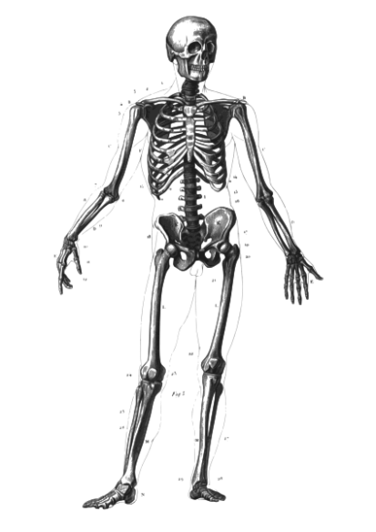

Key Dates
Year 1 -Phonic Screening Check
June 2020
Year 2 -SATs
May 2020

Slide 11



Year 1 Home Learning
Friday – English & Maths
(due Monday)
Friday- Talk Home Learning
Monday- Spellings (to be
tested on Friday)

Slide 12


Year 2 Home Learning
Monday – Spellings (To be tested Thursday)
-Talk Home Learning
Friday – English & Maths (due Monday)

Slide 13


Home Reading
Reading log/record and reading book should be in daily, along with the diary planner.
Red – Year 1 Purple - Year 2
Children should be reading to an adult, for at least 20 minutes every evening.
Encourage asking and responding to questions using thinking skills.
When they have finished reading their book it will be changed in school. Please write finished when your child has finished the book as we will know then to change it. If your child is on Level 6 and above will be changed twice a week. (Monday and Friday)
Please check the Reading Record every night as LSAs or Class Teachers will be writing questions for the children to answer to monitor Reading Comprehension.

Slide 14

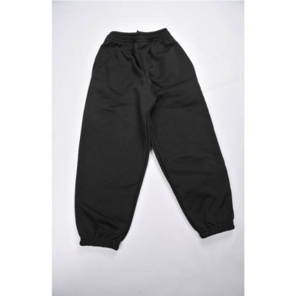


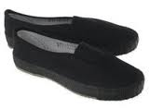
Physical Education
All children are expected to take part in P.E.
PE kit should be in school on correct days
School PE kits should be in all week, with plimsolls and trainers.
Year 1
Heron PE: Monday & Thursday
Swan PE: Wednesday & Thursday
Flamingo PE: Friday & Thursday
Year 2
Peacock PE: Monday & Tuesday
Jay PE: Monday & Thursday
Kingfisher PE: Monday & Thursday

Slide 15




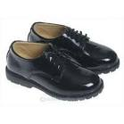

Uniform
Blue jumper or cardigan
Black trousers or skirt
White shirt or t-shirt
Black shoes
Accessories in blue, black or white (scarves & turbans)

Slide 16
Other
School starts at 8:45am and finishes at 3:30pm –All late pupils need to report to the office.
Home time procedures- Parents need to pick pupils up at 3:30pm.
Anyone who is not collected will be sent to the office.
If you need to see a teacher you can make an appointment at the office.
First point of contact is the class teacher, then Mrs. Keane, next Mrs Benton and finally Mr Tatters.

Slide 17

Questions

Slide 18

Thank you for attending
We look forward to working in partnership with you.

