Slide 1

Upper Key Stage 2 Curriculum Meeting
19.09.2019

Slide 2
Upper Key Stage 2 Teachers
Year 5
Eagle – Ms Giga
Hawk – Miss Patel
Osprey – Ms Duong
Year 6
Falcon - Mr Lillie
Harrier - Miss Jandu
Kestrel – Miss Fernando
Deputy Headteacher / SENCO / Phase Leader - Mrs Benton

Slide 3
Upper Key Stage 2 Support Staff
Year 5
Ms Nedyalkova (HLTA)
Mrs Ms O’Shaughnessy (HLTA part time)
Mrs Swann
Mrs Harrish
Year 6
Mrs Petruk (HLTA)
Mrs Chana
Mrs Jan

Slide 4

Westbrook Vision…
Aims
Children are creative learners who are inspired to think and investigate
Children develop and apply skills and knowledge which equips them for life-long learning
Children learn and apply skills/knowledge through first-hand experiences
Children are proud of their learning and aim to achieve their best
Children believe in the value of team work, helping and caring for one another
There are close links with the local community whereby parents are partners in the learning journey
Staff, Governors and the whole community are ambitious and seek to provide only the very best education for our children

Slide 5
Westbrook Vision…
Aims
We will achieve our aims by:
Teaching life skills to the children and involving parents
Providing opportunities for parents and the community to participate in the life of the school
Celebrating achievement and success (rewards, assemblies etc.)
Participating in community events (sporting, learning etc.)
Embedding and apply thinking skills throughout the curriculum
Providing a curriculum which is broad and balanced which also encourages: resilience, confidence, independence, inclusivity, creative thinking and enquiry
Providing first-hand experiences so that deep and lasting connections are made between areas of knowledge
Investing in our staff and Governors so they are highly equipped to provide the very best education for our children

Slide 6
The curriculum…
Assessing:
Children are assessed every term in core subjects, including SPaG
We use the following terms:
Commencing, Developing, Expected, Mastery (Greater Depth)
Children are targeted to move from Commencing to Expected by the end of the academic year.

Slide 7
End of KS2 Assessments
Written tests in:
Reading
Maths
Spelling, Grammar & Punctuation
Teacher Assessment:
Writing assessed over time
SATs Meeting will be held closer to the assessment period for parents of children in Year 6

Slide 8



English - reading
All children should be reading everyday
Their reading books should brought to school and taken home everyday (book of their choice and from Wonder World)
Record comments about your child’s reading in the Reading Record on a regular basis
Children should also be recording comments about the books that they read
Encourage children to read for enjoyment and a number of different fiction and
non-fiction texts
Encourage your child to read when out and about e.g. road signs, menus, food packaging
Visit the local library in Heston

Slide 9

Reading Records

Slide 10

Destination Reader
Destination Reader is a new approach to teaching reading in KS2. It involves daily sessions incorporating whole class modelling prior to the children applying these skills through partner work and independent reading.
Skills include: predicting, inferring,
evaluating, clarifying and
summarising

Slide 11
KS2 (English - Writing)
Year 6: Detail of content to be introduced (statutory requirement)
Word
Vocabulary typical of informal speech and vocabulary appropriate for formal speech and writing [for example, find out – discover; ask for – request; go in – enter]
Recognition and application of synonyms and antonyms [for example, big, large, little]
Sentence
Use of the passive to affect the presentation of information in a sentence [for example, I broke the window in the greenhouse versus The window in the greenhouse was broken (by me)].
The difference between structures typical of informal speech and structures appropriate for formal speech and writing [for example, the use of question tags: He’s your friend, isn’t he?, or the use of subjunctive forms such as If I were or Were they to come in some very formal writing and speech]

Slide 12
Writing
Text Linking ideas across paragraphs using a wider range of cohesive devices: repetition of a word or phrase, grammatical connections [for example, the use of adverbials such as on the other hand, in contrast, or as a consequence], and ellipsis
Layout devices [e.g. headings, sub-headings, columns, bullets, or tables]
Punctuation Use of the semi-colon, colon and dash to mark the boundary between independent clauses [for example, It’s raining; I’m fed up]
Use of the colon to introduce a list and use of semi-colons within lists
How hyphens can be used to avoid ambiguity [for example, man eating shark versus man-eating shark, or recover versus re-cover]
Terminology for pupils
subject, object
active, passive
synonym, antonym
ellipsis, hyphen, colon, semi-colon, bullet points

Slide 13
Writing

Slide 14
Writing…
Big Writing lessons completed on a weekly or fortnightly basis to give the children lots of experience of writing at length independently
Please support your child by discussing the subject or scenario given for Big Talk home-learning

Slide 15


Maths…
Number (place value, + - x ÷, fractions)
Measurement (volume, converting units)
Geometry (Properties of shapes, position and direction)
Statistics (interpreting information in tables)
In addition, Year 6 learn about:
Ratio and proportion
Algebra

Slide 16
Maths…
Children will be set termly targets in maths linked to the National Curriculum.
These will be written in the home-learning diaries for you to see

Slide 17
Westbrook Wonder World Curriculum……
The purpose of our new curriculum is to incorporate key elements of our vision into the teaching of all subject areas e.g. Thinking Skills and hands-on experiences.
Retaining effective aspects of the topics previously taught e.g.
We are keeping all the good parts of what we currently do but extending it further to ensure the children are developing ‘in-depth’ knowledge
A more subject style specific approach.
All the subject specific units will begin with an exciting Entry Point to hook the children into the new unit. Followed by a ‘Knowledge Harvest’ lesson to assess their prior knowledge and then discuss what they want to learn. This is then used to plan the half term lessons using our ‘thinking skills’ techniques and approaches. At the end of each unit, an Exit Point will take place as a chance to celebrate all the learning.

Slide 18
Westbrook Wonder World Curriculum…
 |  | Autumn Term
Year 5 | Science | Life cycles; Earth & Space
 | History | Anglo-Saxons
 | Geography | Changes in the Local Environment
 | Art | Chinese Art
 | DT | Chinese Interventions
 | Music | Livin’ on a prayer, Jazz
Year 6 | Science | Our bodies; Light & Sound
 | History | The impact of WWI & WWII
 | Geography | Global Warming
 | Art | Gustav Klimt
 | DT | Great British Dishes
 | Music | Pulse and rhythm

Slide 19




Key Texts…
 | Autumn | Spring | Summer
Year 5 | Stig of the Dump | Wonder | Journey to the River Sea
Year 6 | Goodnight Mister Tom | Cosmic | Skellig

Slide 20
Home-learning
Your child will be set a range of home-learning activities throughout the week that need to be completed and returned to school for the class teacher to mark
Home-learning is very important as it allows your child to consolidate what they have been learning in class
Please support your child to complete their home-learning and discuss with them what they have been doing at school
Help to create a suitable environment for completing home-learning and try to establish a routine
Home-learning diaries – targets, home-school agreement

Slide 21


Year 5 Home-Learning
Home-learning given out |  | Home-learning returned to school
Day | Details | Day
Monday | Reading (approx. 10 pages)
Tuesday | Spellings and English | Monday
Wednesday | Maths | Monday
Thursday | Big Talk related to the Big Write on Friday | Friday
Friday | Westbrook Wonder World | Tuesday
  Read daily and write comments in Reading Record 4 times a week

Slide 22
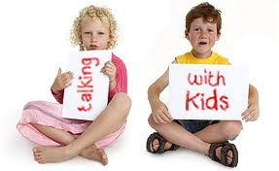

Year 6 Home-Learning
Home-learning given out |  | Home-learning returned to school
Day | Details | Day
Monday | Spelling | Following Monday
Tuesday | English | Monday
Wednesday | Maths | Monday
Thursday | Big Talk | Friday
Friday | Various subjects | Following Monday
Additional activities from revision sessions.
Incomplete revision tasks to be completed at home.
Read daily and write comments in Reading Record 5 times a week.

Slide 23
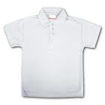



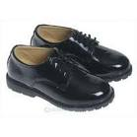

Uniform
The royal blue uniform is available from www.yourschooluniform.com
Or from the school hall on Tuesdays and Thursdays from 2.45pm to 3.15pm (bookbags and t-shirts)
Blue jumper or cardigan
Black trousers or skirt
White shirt or t-shirt
Black shoes
Accessories in blue, black or white

Slide 24
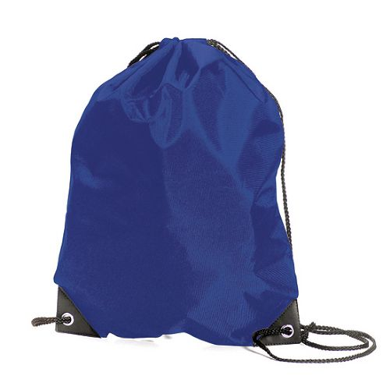

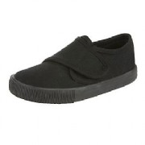
Physical Education
* Please ensure that your child has the correct PE kit in school on the correct days
* No jewellery for safety reasons
* Long hair to be tied back
* Correct footwear that fits
* Plain black trainers can be worn for outdoor lessons
* PE kit can stay in school for the week and be taken home on a Friday

Slide 25
PE
P.E. Days
Eagle – Wednesday (swimming) & Monday
Hawk – Thursday (swimming) & Friday
Osprey - Tuesday (swimming) & Friday
Falcon - Tuesday & Wednesday
Harrier –Monday & Wednesday
Kestrel - Thursday & Friday

Slide 26

Collection of children
Please also let us know if you are not going to be collecting your child at the end of the day (3.30pm) and tell us the name of the person who is (write a letter, speak to the class teacher or inform the office)
If another grown-up is going to collect your child on a regular basis we also need to have this in writing
Older siblings are not allowed to collect your child unless they are over 16.
If possible, try to introduce the person, who is going to collect your child, to the class teacher beforehand
Please give written permission if you allow your child to walk home from school

Slide 27
Attendance
Please ensure children are in school on time.
The gates open at 8.30am and registration is taken at 9:00am
Please supervise your child whilst in the playground before registration and after school at the end of the day
Attendance is very important to maintain consistency in learning patterns and for children to progress. We are working very hard at Westbrook to ensure that our rates of attendance are as high as possible and above the national average of 96%
Year 6 are coming into school for 8:00am to support their studies for the SATs

Slide 28

Birthday Books…
If you would like to mark your child’s birthday, we would ask that you donate a book to your child’s class library rather than bringing in food items for the class. Your child will be able to share this book with the class before adding it to the class library. If you have a book to donate please see the office for one of our special labels to put inside.

Slide 29
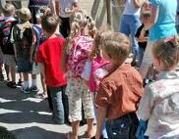
Independence…
As your children grow older, the more independent they will become. It is vital that children gain the experience of being responsible for their own things. It would be extremely helpful if children come into school, with all their belongings ready to start the school day e.g. bookbag, water bottle and PE kit.

Slide 30
Extra information…
Please fill out the Free School Meal application forms online if you think you might be eligible
Onside – before school and after school care and sports activities during the day. They will be delivering different physical activity sessions during lesson time and lunch time.

Slide 31


Thank you for attending the Upper Key Stage 2 Curriculum meeting.
We look forward to working in partnership with you.
Please feel free to ask staff any questions you may have.

